Slide 1
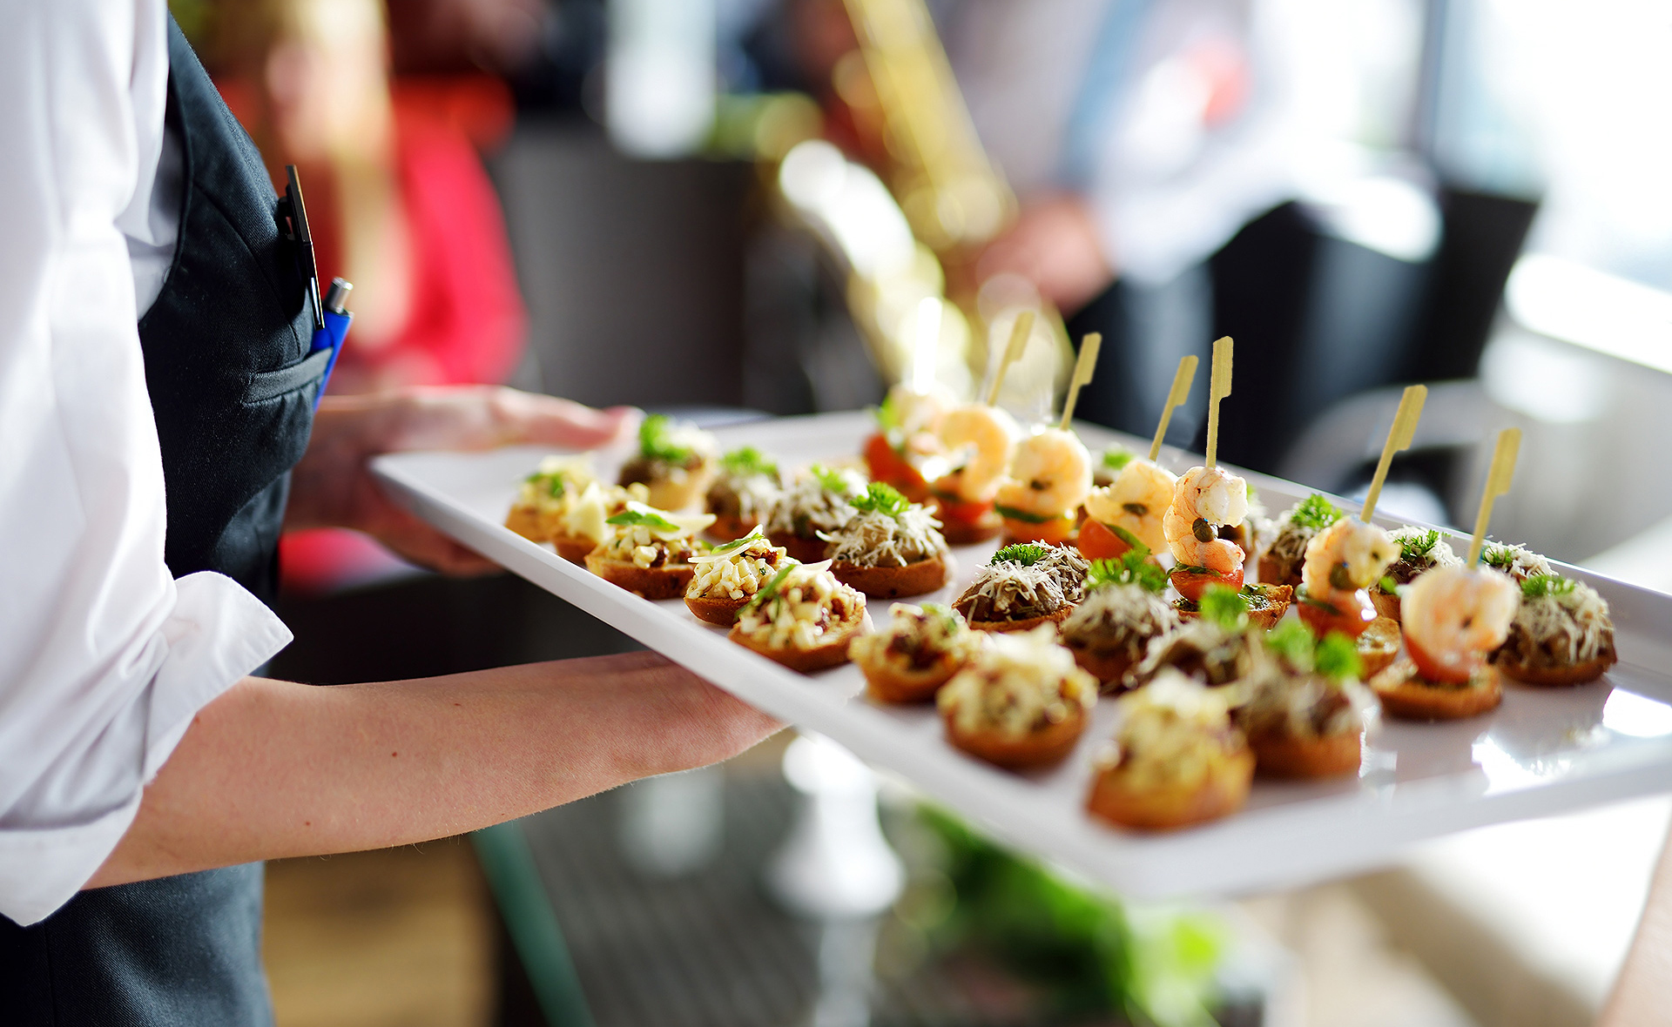
CATERING MENU
CROWNE PLAZA LOS ANGELES HARBOR
601 S. PALOS VERDES STREET, SAN PEDRO CA 90731 | 310-521-8046
WWW.CROWNPLAZALAHARBORHOTEL.COM

Slide 2
CATERING & EVENTS AT CROWNE PLAZA LOS ANGELES HARBOR
CATERING FAQ’S
HOURS OF SCHEDULED EVENTS
FOOD AND BEVERAGE MINIMUMS
TABLES AND SET UP
Private events include up to 5 hours of contracted time. Daytime events must conclude no later than 3:00pm and evening events can be scheduled to start at 5:00pm or later. If the client requires use of the venue outside of these time frames, additional fees will apply and must be preapproved by the hotel. All event spaces may be reserved for the entire day for events requiring early set-up and are based upon availability and priced accordingly.
All event spaces at CPLA require a food and beverage minimum. These minimum requirements are exclusive of the current taxable service charge and sales tax that are applicable to all food and beverage items. Site rental fee is subject to current applicable sales tax. Minimums are subject to change.
Each event space is equipped with a combination of 60” & 72” Rounds with up to (8-12) guests. If you provide the number of guests for each table we will set accordingly. CPLA supplies complimentary white, ivory or black colored linens (floor length can be arranged at an additional cost), overlays and napkins. A personalized layout will be provided by your Catering representative. CPLA provides blue and gold banquet chairs, china, silver & stemware. Dance floor (24x24) and riser are available at additional cost. Decorations that tape, glue, tack, or otherwise adhere to any surface in rooms is not allowed. Glitter and Confetti is not allowed . Candles are allowed as long as they are enclosed in a hurricane or votive. No open flame will be permitted.
FOOD AND BEVERAGE PROVISIONS
CPLA is the sole purveyor of all food & beverages for on-site events unless otherwise stated in writing. The State of California Liquor Commission regulates the sale & service of alcoholic beverages, and CPLA must adhere to these regulations. Please Note: Guests who appear to be under age 21 and do not have valid ID will not be served. CPLA reserves the right to refuse beverage service.
CPLA EVENT DETAILS
Your Catering representative will be able to assist in detailed planning and preparations for your event. We encourage the menu and all other details to be finalized two (2) weeks prior to your event date. The guaranteed guest count is due Five (3) days in advance. Please note that you will not be charged for less than your guaranteed guest count. If your actual count exceeds your guarantee you will be billed accordingly. CPLA will prepare 3% over your guarantee.
PARKING
CPLA offers underground parking for you and your guests at an event rate of $15 per car.
TASTINGS
Tastings are offered for weddings only, after a confirmed booking and include (2) Starters and (3) Entrees. Tastings are scheduled in advance and can take place on Wednesday’s and Thursday’s at 2:00pm or 3:00pm.
DEPOSIT SCHEDULE
WEDDING COORDINATORS
To confirm your CPLA event a non-refundable and non-transferable 25% deposit of estimated charges for your specific event space is due within seven (7) days of receiving the contract. Full payment of the estimated charges is due ten (10) days prior to your event. All deposits are non-refundable or transferable.
All wedding ceremonies and receptions hosted at CPLA are required to hire a licensed, professional coordinator for a minimum of 1 month’s service prior to the contracted event day. Coordinators must be from the CPLA approved vendor list..
ENTRÉE CHOICES
You may offer your guests a choice between (3) entrees (2 proteins and 1 vegetarian). CPLA requires utilizing escort cards. If you choose to offer a choice of entrée, your guaranteed number of each entrée should be submitted ten (10) business days prior to your event. An individual place card with your guests’ predetermined entrée selection noted is required.
PREFERRED VENDORS
The Catering Department can provide you with referrals for outside vendors, please inquire for list.

Slide 3
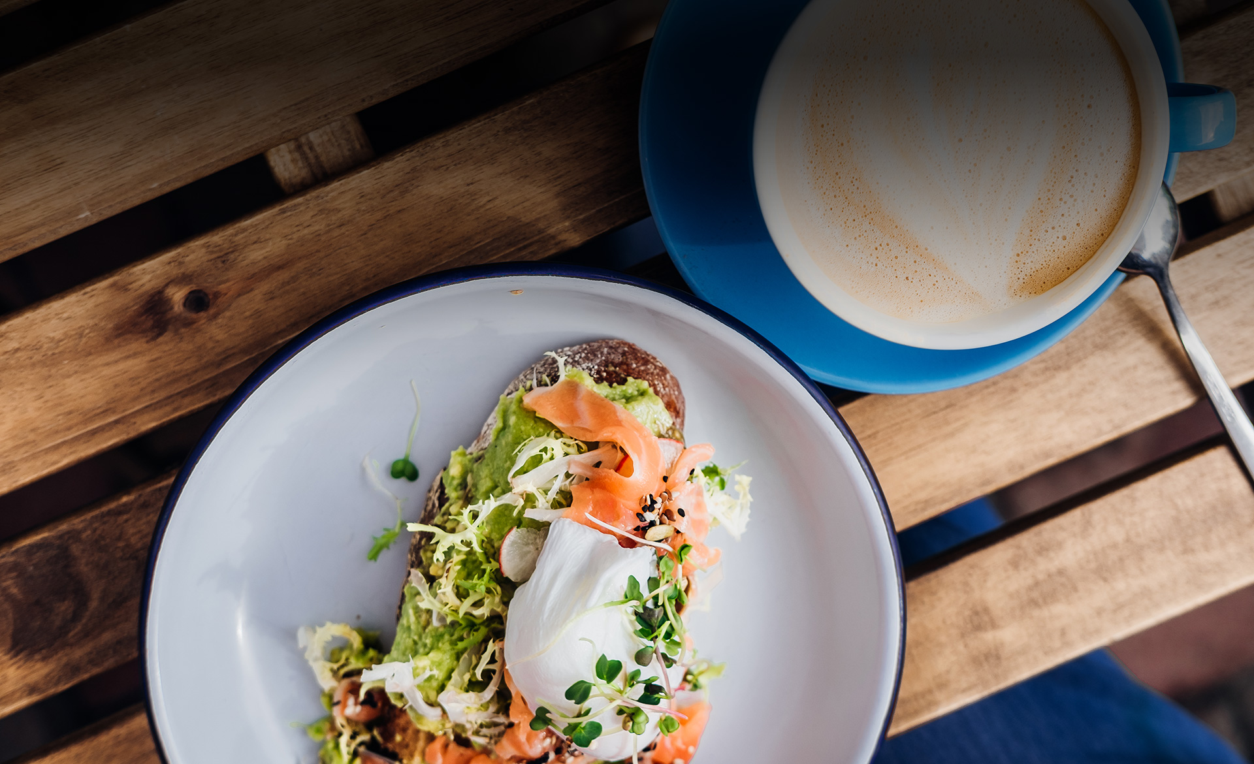
CATERING AT CROWNE PLAZA
BREAKFAST

Slide 4
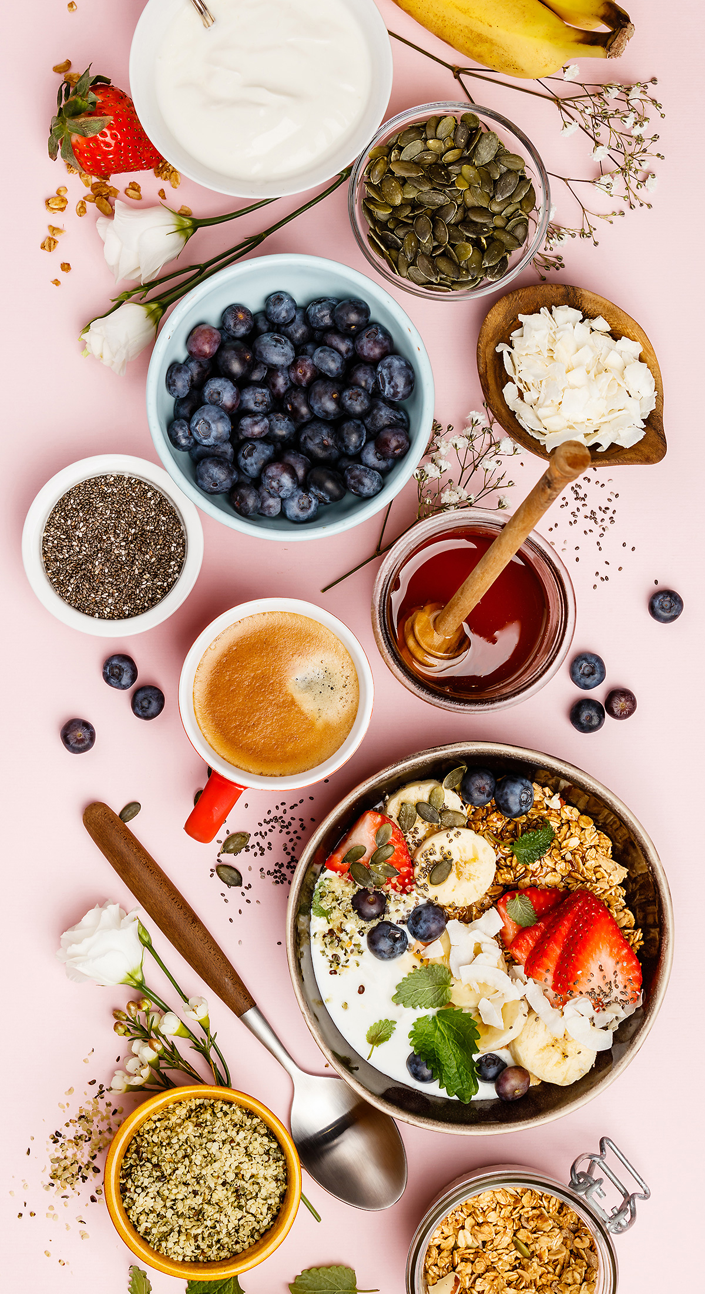
BREAKFAST
BUFFET
Buffets require a minimum of 25 guests: (1) Hour of Service: Priced Per Person
COFFEE + BIGELOW TEAS | ORANGE + CRANBERRY JUICE
CONTINENTAL | $ 22 per guest
Sliced seasonal fruit
Breakfast breads & pastries, sweet whipped butter, preserves
Fresh fruit juices
Freshly brewed coffee and assorted hot teas
ALL AMERICAN | $ 33 per guest
Sliced seasonal fruit
Breakfast breads & pastries, sweet whipped butter, preserves
Build your own yogurt parfaits
Farm fresh scrambled eggs
Applewood smoked bacon, pork sausage links or turkey sausage
Roasted potatoes with onion & bell peppers
Fresh fruit juices
Freshly brewed coffee and assorted hot teas
THE BAJA | $ 38 per guest
Sliced seasonal fruits
Chilaquiles~ fried corn tortillas, red tomato and chile cascabel sauce, cojita cheese and red onion
Mini breakfast burritos~ scrambled eggs, applewood smoked bacon, pork sausage or chorizo, potatoes o’brien, cheddar & jack cheese
Refried Beans
Pico de gallo, salsa verde, sour cream and guacamole
Fresh fruit juices
Freshly brewed coffee and assorted hot teas
All pricing is per person, a 21% taxable service charge and 9.5% sales tax will apply to all food and non-liquor beverage. Pricing ,sales tax and service charge are subject to change.

Slide 5
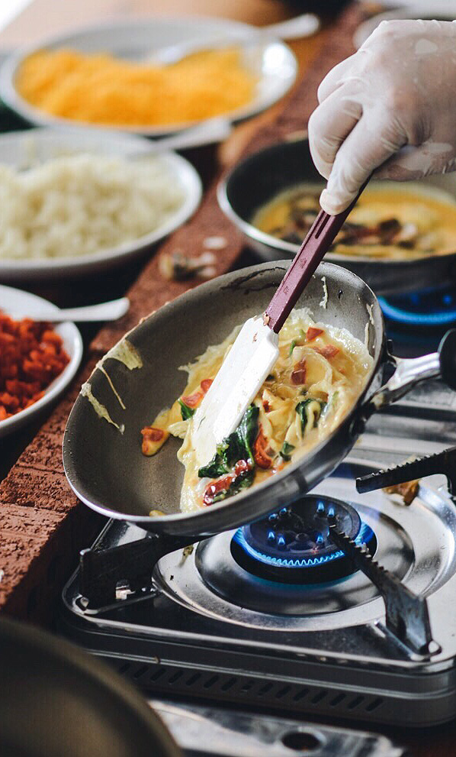
BREAKFAST
STATIONS
Stations require a minimum of 25 guests: (1) Hour of Service: Priced Per Person
Stations cannot be served as standalone items. They must be served in conjunction with a breakfast buffet. All stations require a chef attendant -$150 per attendant
OMELET STATION | $ 18 per guest
Whole eggs, egg whites, applewood smoked bacon, black forest ham, pork or turkey sausage, artichokes, olives, bell peppers, mushrooms, red onion, spinach, tomatoes, cheddar & jack cheese, guacamole, sour cream, pico de gallo, salsa verde
CLASSIC BELGIAN WAFFLE STATION | $ 15 per guest
Whipped butter, warm maple syrup, seasonal berries, bananas, chocolate chips, walnuts, whipped cream
AVOCADO TOAST STATION | $ 16 per guest
Multigrain bread, smashed avocado, roasted cherry tomatoes, microgreens, pickled onions,
radish, Applewood smoked bacon, mozzarella, capers, balsamic glaze, olive oil, “everything but
bagel” seasoning, salt, pepper, paprika
ENHANCEMENTS
Enhancements cannot be served as stand alone items.
Must be served in conjunction with a breakfast buffet.
STEELE CUT OATMEAL | $ 8 per guest
Butter, brown sugar, roasted nuts, golden raisins and maple syrup
AVOCADO TOAST | $ 10 per guest
Grilled multigrain bread, avocado, roasted cherry tomatoes, microgreens, "everything"
bagel seasoning
MIMOSA & BELLINI BAR | $ 22 per guest
Champagne, orange juice, cranberry juice, strawberry puree, mango puree, seasonal berries
All pricing is per person, a 21% taxable service charge and 9.5% sales tax will apply to all food and non-liquor beverage. Pricing ,sales tax and service charge are subject to change

Slide 6
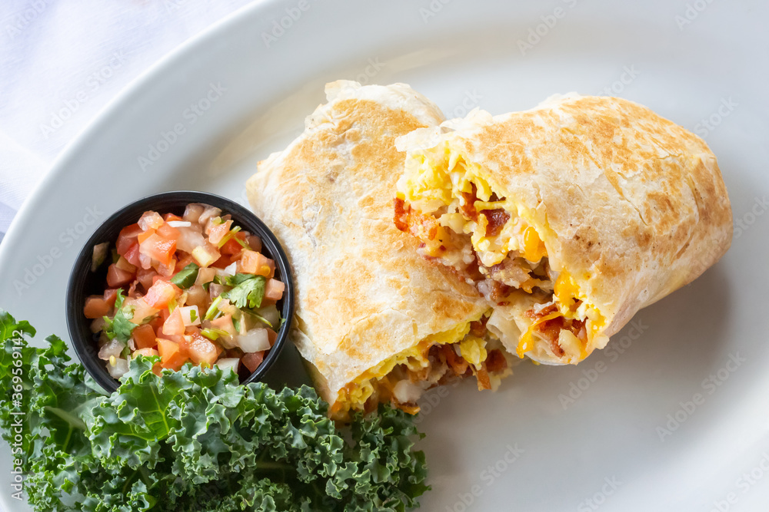
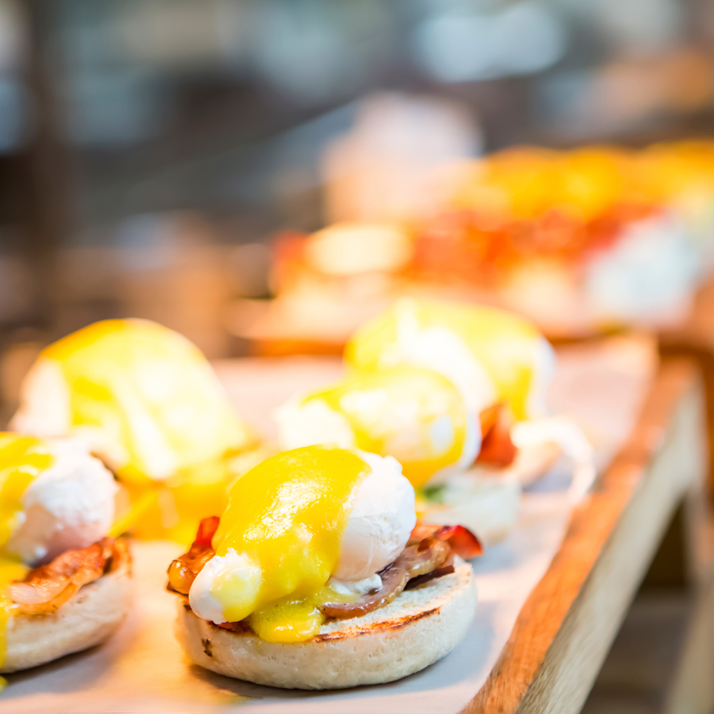
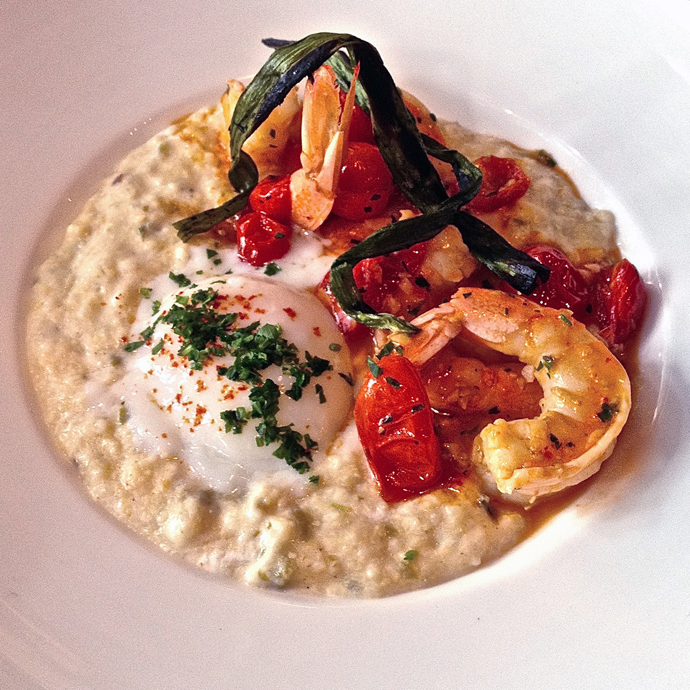
BREAKFAST
PLATED
Plated Breakfasts require a minimum of 15 guests: Priced Per Person
Select up to (2) Entrées. Entrée counts due 5 days prior to your event
All Plated Breakfasts Include: Freshly Brewed Coffee, Assorted Tea, Chilled Orange Juice, Fresh Fruit Garnish
SUNRISE | $ 25 per guest
BREAKFAST BURRITO | $ 23 per guest
Biscuits or croissants
Farm fresh scrambled eggs
Applewood smoked bacon OR chicken apple sausage
Roasted breakfast potatoes
Scrambled eggs, Applewood smoked bacon,
pork sausage or chorizo, hash browns,
cheddar & jack cheese, salsa
AVOCADO TOAST | $ 25 per guest
EGGS BENEDICT | $ 28 per guest
Grilled multigrain bread, smashed avocado, roasted cherry tomatoes, microgreens, "everything" bagel seasoning, fried eggs
Roasted breakfast potatoes
Poached eggs, Canadian bacon, English muffin, hollandaise sauce
Roasted breakfast potatoes
EGGWHITE POWER BOWL | $ 28 per guest
Quinoa, spinach, scrambled egg whites, feta, roasted cherry tomatoes, avocado,
Multigrain toast
All pricing is per person, a 21% taxable service charge and 9.5% sales tax will apply to all food and non-liquor beverage. Pricing ,sales tax and service charge are subject to change

Slide 7
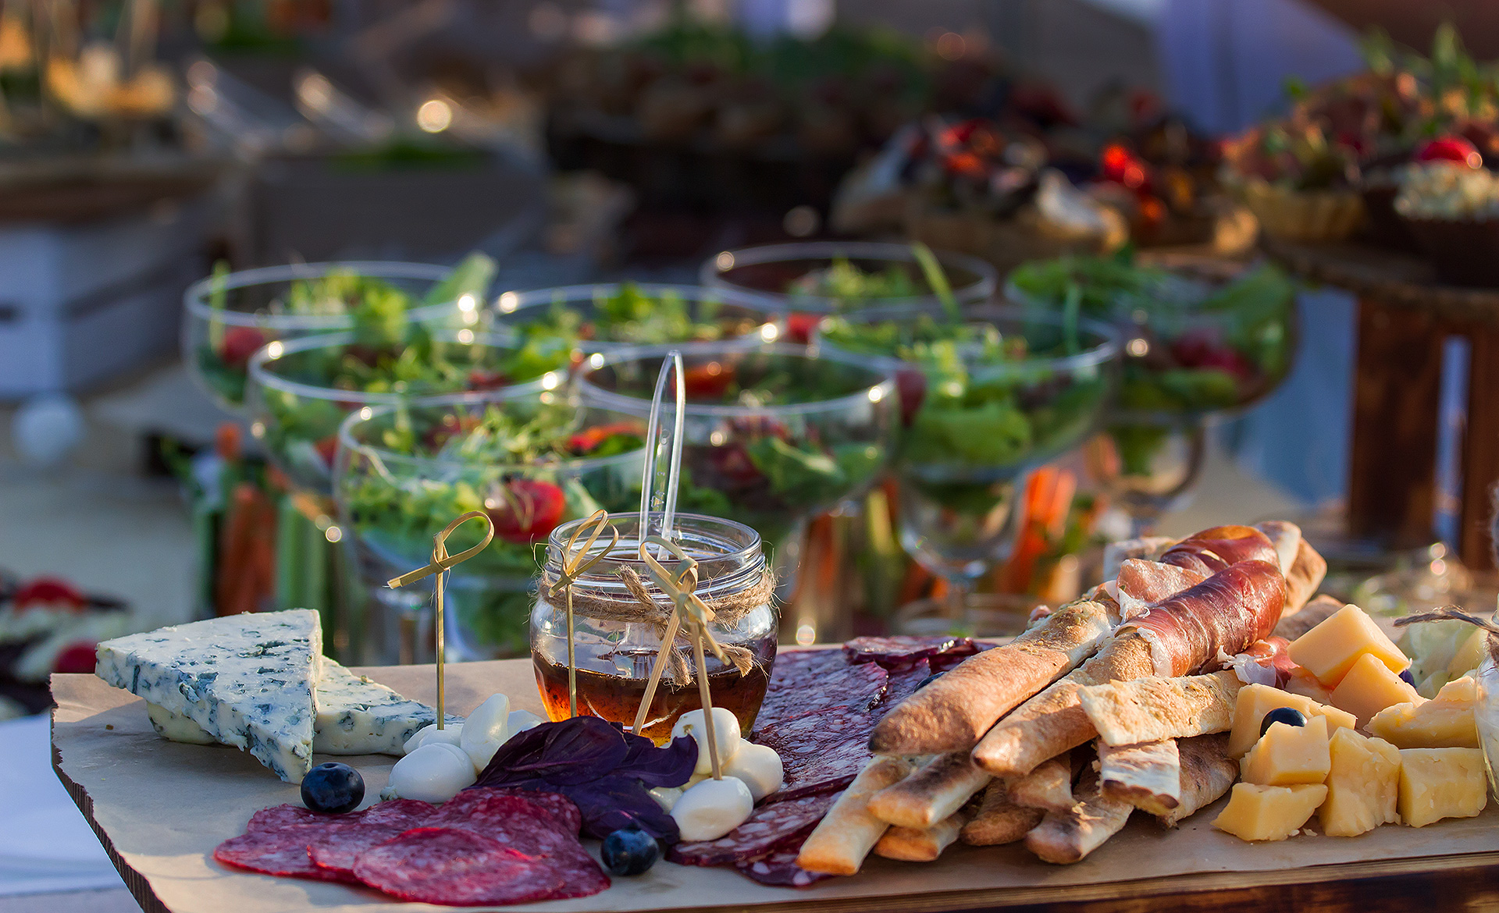
CATERING AT CROWNE PLAZA
MEETINGS, BREAKS & BOX IT UP

Slide 8
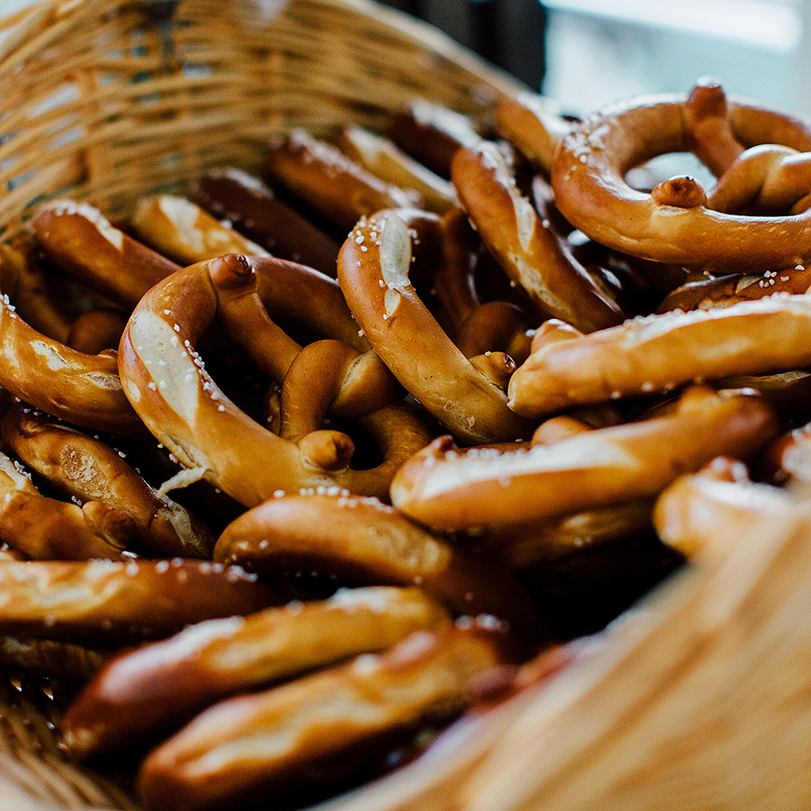
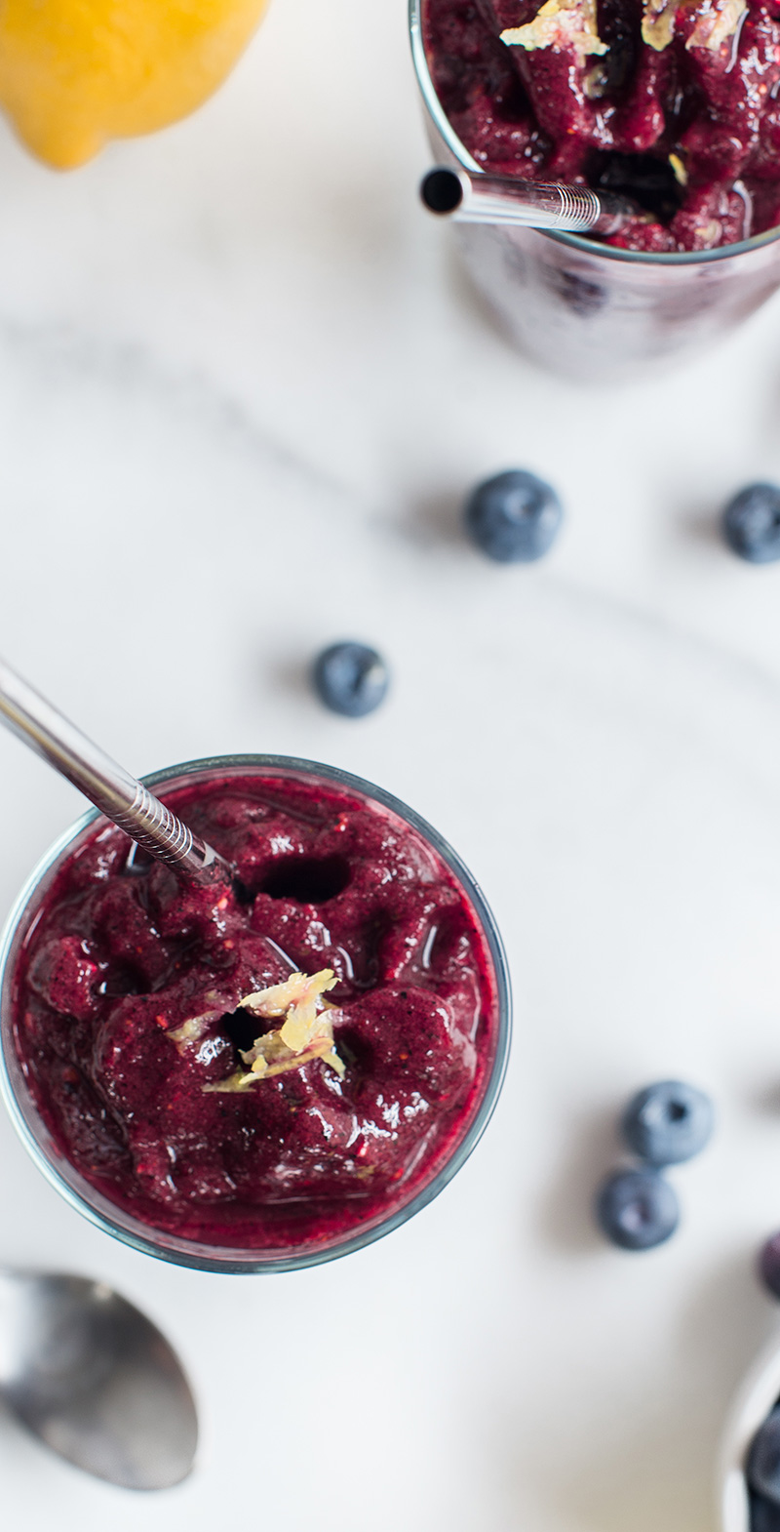
MEETINGS
ALL DAY MEETING PACKAGE
All Day Meeting Package requires a minimum of 25 guests: Additional $75 Fee Applies to all Groups Less Than 25 People
$ 95 per guest
CONTINENTAL BREAKFAST
Sliced seasonal fruit
Breakfast breads & pastries, sweet whipped butter, preserves
Fresh fruit juices
Freshly brewed coffee and assorted hot teas
MID MORNING BEVERAGE REFRESH
LUNCH~ SELECT FROM ONE OF OUR SIGNATURE LUNCH BUFFETS (Page 14)
Incudes Iced Tea & Assorted Sodas
Southern Comfort
A Taste of Italy
Fiesta
Pacific Rim
Deli
AFTERNOON BREAK~ SELECT FROM ONE OF THE FOLLOWING BREAK OPTIONS
Beverage Refresh, Coffee, Sodas and Water Station
Cookie Break~ Assorted chocolate chip, oatmeal raisin, peanut butter, milk
Health Nut Break~ Assorted granola & fruit bars, trail mix, seasonal sliced fresh fruit, mixed nuts
Cinema~ Warm popcorn, soft pretzels with mustard, salted peanuts, assorted candy
Fiesta Break~ Tortilla chips with salsa, guacamole & queso dip, warm churros
All pricing is per person, a 21% taxable service charge and 9.5% sales tax will apply to all food and non-liquor beverage. Pricing ,sales tax and service charge are subject to change

Slide 9
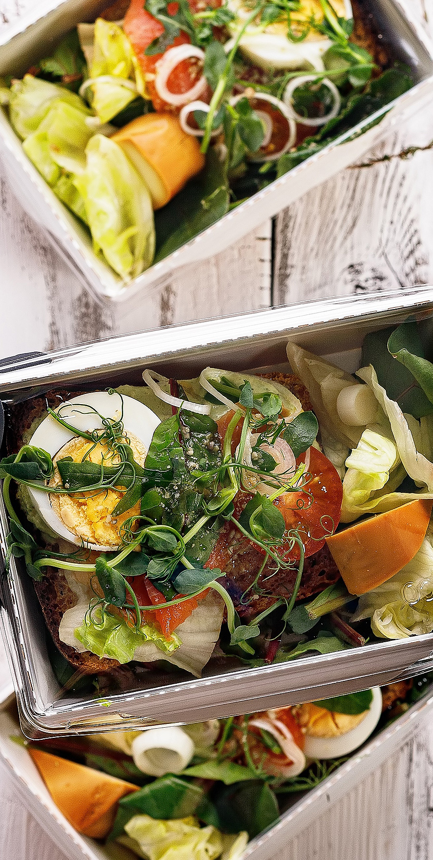
BREAKFAST & LUNCH
BOX IT UP
COFFEE + BIGELOW TEAS | ORANGE + CRANBERRY JUICE
Box it up requires a minimum of 25 guests: Additional $75 Fee Applies to all Groups Less Than 25 People
BREAKFAST | $ 28 per guest
Whole fresh fruit
Individual yogurt cup; assorted flavors
Assorted wrapped muffins and pastries
Hard boiled eggs
Bottled juices or tea
Bottled water
LUNCH | $ 35 per guest
Includes: Fresh Whole fruit, Kettle Chips, a Freshly-Baked Cookie and Bottled Water
Choice of Two Sandwiches & /or Wraps:
Turkey Club~ sour dough, avocado, lettuce, tomato, bacon, cheddar cheese, mayo
Black Forest Ham~ rye, gruyere, dijonnaise, lettuce, tomato
Classic BLT~ sourdough, applewood smoked bacon, romaine, tomato, aioli
Grilled Chicken Caesar Wrap~ flour tortilla, romaine lettuce, diced tomatoes, shaved parmesan cheese, Caesar dressing
Tuna Salad Wrap~ whole wheat wrap, baby kale, olive tapenade, oven-roasted tomatoes
Italian Wrap~ herb tortilla, sliced salami, provolone cheese, shredded lettuce, olives, pepperoncini, tomato, italian vinaigrette, spinach
All pricing is per person, a 21% taxable service charge and 9.5% sales tax will apply to all food and non-liquor beverage. Pricing ,sales tax and service charge are subject to change

Slide 10
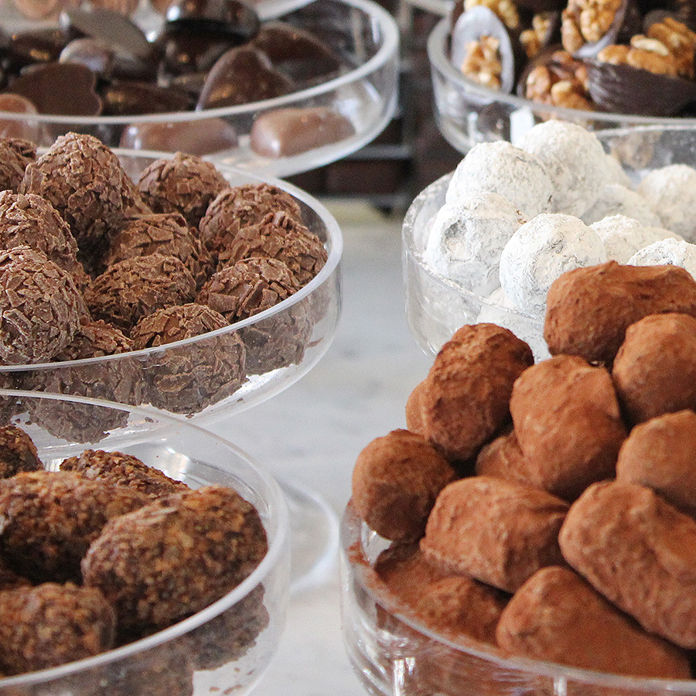
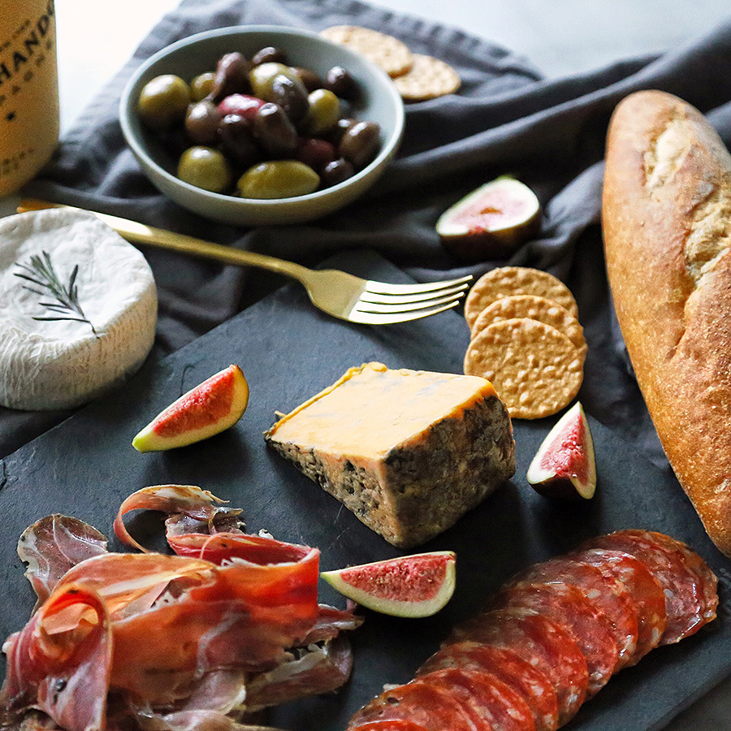
BREAKS
ANYTIME
Anytime Breaks requires a minimum of 25 guests: Additional $75 Fee Applies to all Groups Less Than 25 People
ALL DAY BEVERAGES | $ 24 per guest
COOKIE BREAK | $ 18 per guest
Assorted bottled fruit juices
Assorted soft drinks and bottled water
Freshly brewed coffee and assorted hot teas
Includes all-day beverage refresh
Chocolate chip, oatmeal raisin, peanut butter
Milk
Assorted soft drinks and bottled water
HEALTH NUT | $ 25 per guest
MEDITERRANEAN | $ 25 per guest
Assorted mixed nuts
Trail mix
Seasonal sliced fresh fruit
Assorted power bars and granola bars
Assorted power drinks and bottled water
TERRA™ chips
Hummus and pita
Seasonal sliced fresh fruit
Vegetable Crudité with ranch dressing
Assorted soft drinks and bottled water
CINEMA | $ 22 per guest
NAPA | $ 30 per guest
Warm popcorn
Soft pretzels with mustard
Salted peanuts
Assorted candy
Assorted soft drinks and bottled water
Domestic & imported cheese
Assorted charcuterie
Apricot mustard and pickled vegetables
Grapes, apricots, mixed nuts and rustic breads
Assorted soft drinks and bottled water
All pricing is per person, a 21% taxable service charge and 9.5% sales tax will apply to all food and non-liquor beverage. Pricing ,sales tax and service charge are subject to change

Slide 11
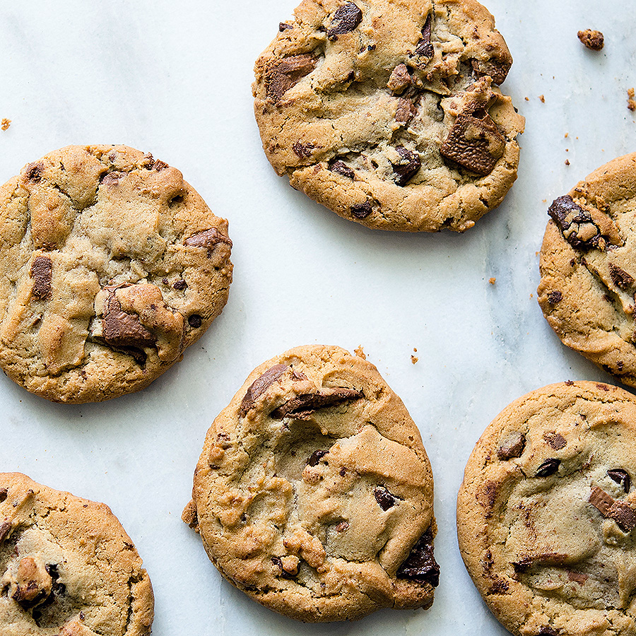
BREAKS
A LA CARTÉ ITEMS
A La Carte Items are charged upon consumption, unless otherwise specified during the planning phase.
COFFEE & TEA
Freshly brewed coffee $58 per gallon
Freshly brewed iced tea $58 per gallon
Assorted hot teas $3 per person
BOTTLED BEVERAGES
Assorted soft drinks, bottled still or sparkling water, bottled juices or teas, coconut water, bottled milk $5 each
BARS
Assorted granola bars, Kind™ bars, organic energy bars $5 each
BAGGED
Assorted bagged chips, TERRA™ chips, popcorn, trail mix $4 each
FRUITS & PARFAITS
Whole fresh fruit $3 each
Yogurt, granola and fruit parfaits $6 each
BY THE DOZEN
Assorted muffins & pastries $38 per dozen
Assorted bagels & shmear $38 per dozen
Freshly-baked assorted cookies, brownies or lemon bars $40 per dozen
All pricing is per person, a 21% taxable service charge and 9.5% sales tax will apply to all food and non-liquor beverage. Pricing ,sales tax and service charge are subject to change

Slide 12
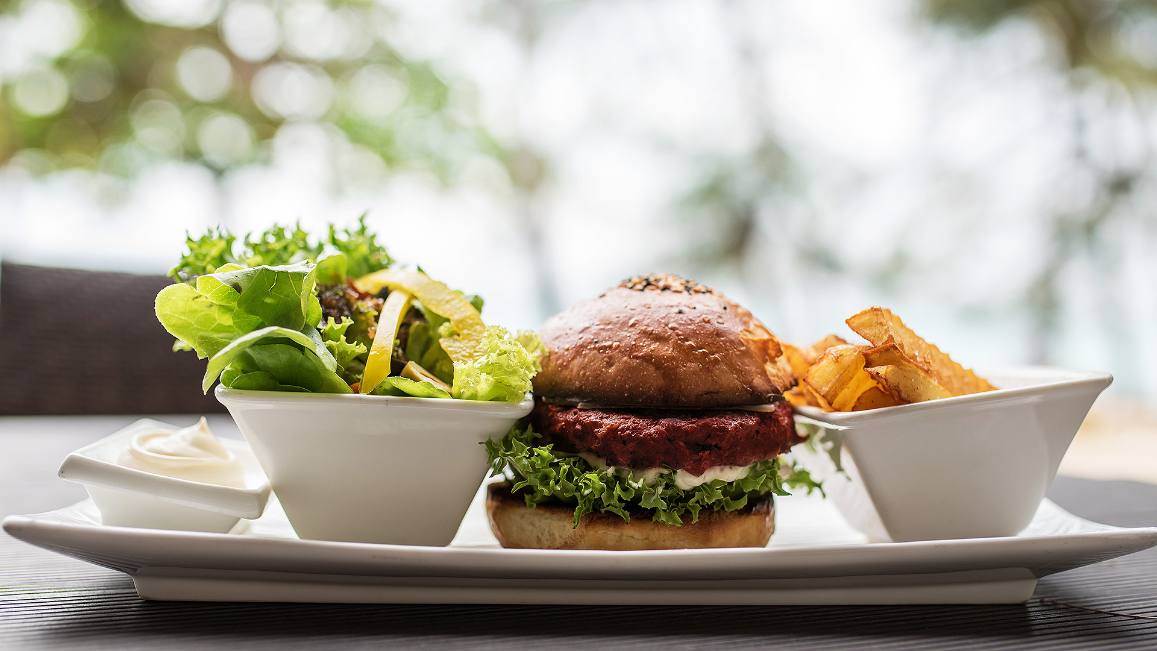
CATERING AT CROWNE PLAZA
LUNCH

Slide 13
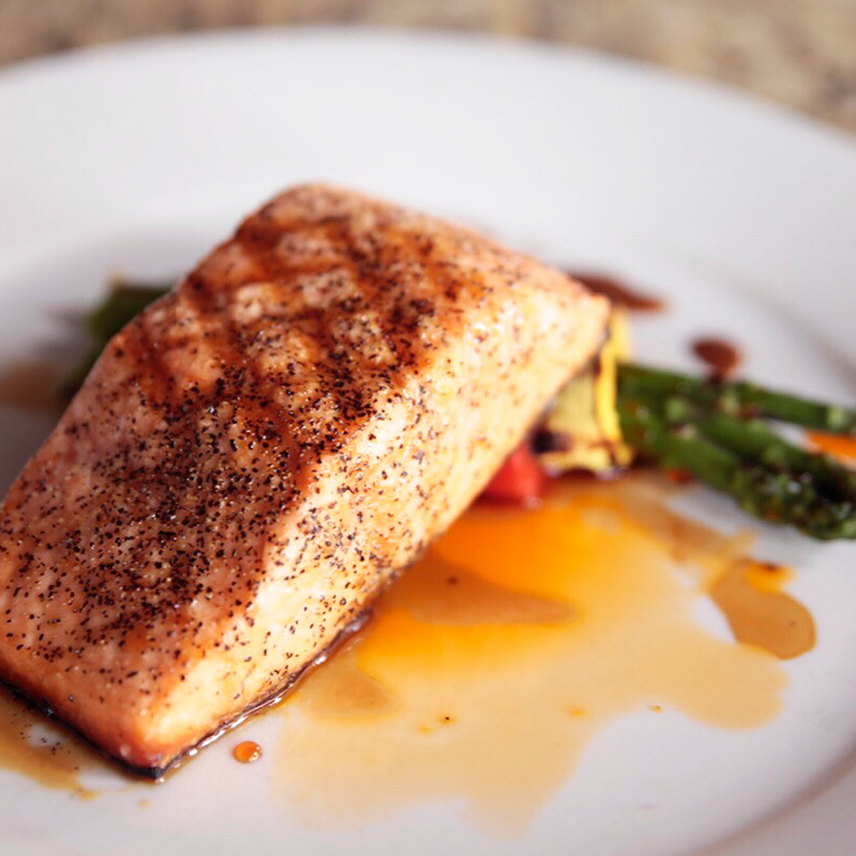
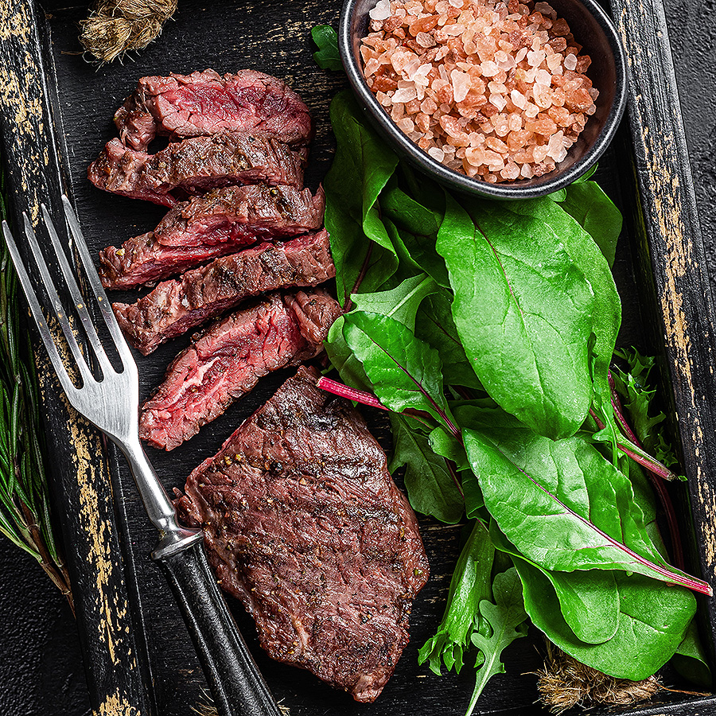
LUNCH
BUFFET LUNCH
Buffet require a minimum of 25 guests: (1) Hour of Service: Priced Per Person
Includes: Freshly Brewed Coffee, Assorted Hot Tea, Iced Tea
Artesian Bread & Butter, Chefs Selection of Mini Desserts
THE PORTS OF CALL
Choice of One Entrée – $39 per guest
Choice of Two Entrées – $47 per guest
Choice of Two Salads:
Classic Caesar~ hearts of romaine, sourdough croutons, shaved parmesan cheese, Caesar dressing
Thai Citrus Salad~ napa cabbage, snow peas, cilantro, mandarin oranges, cashews, toasted sesame vinaigrette
Roasted Beet Salad~ mixed greens, goat cheese, dried cranberries, toasted pecans, lemon vinaigrette
Market Salad~ feta, candied walnuts, cucumber, radish, lemon herb vinaigrette
Mixed Baby Greens~ julienne carrots, cucumber, baby tomatoes, radish, balsamic vinaigrette, ranch
Choice of Two Sides:
Roasted red potatoes
Roasted brussels sprouts
Sautéed seasonal vegetables
Israeli couscous
Garlic mashed potatoes
Wild rice
Entrées:
Roasted Chicken Breast~ wild mushroom marsala sauce
Chicken Picatta~ lemon caper beurre blanc
Pork Loin~ thyme honey mustard glaze
Herb Crusted Baked Salmon
Blackened Mahi Mahi~ mango & tomatillo salsa
Sliced Roasted Top Sirloin~ gorgonzola sauce
Grilled Tofu~ seasonal vegetables
All pricing is per person, a 21% taxable service charge and 9.5% sales tax will apply to all food and non-liquor beverage. Pricing ,sales tax and service charge are subject to change

Slide 14
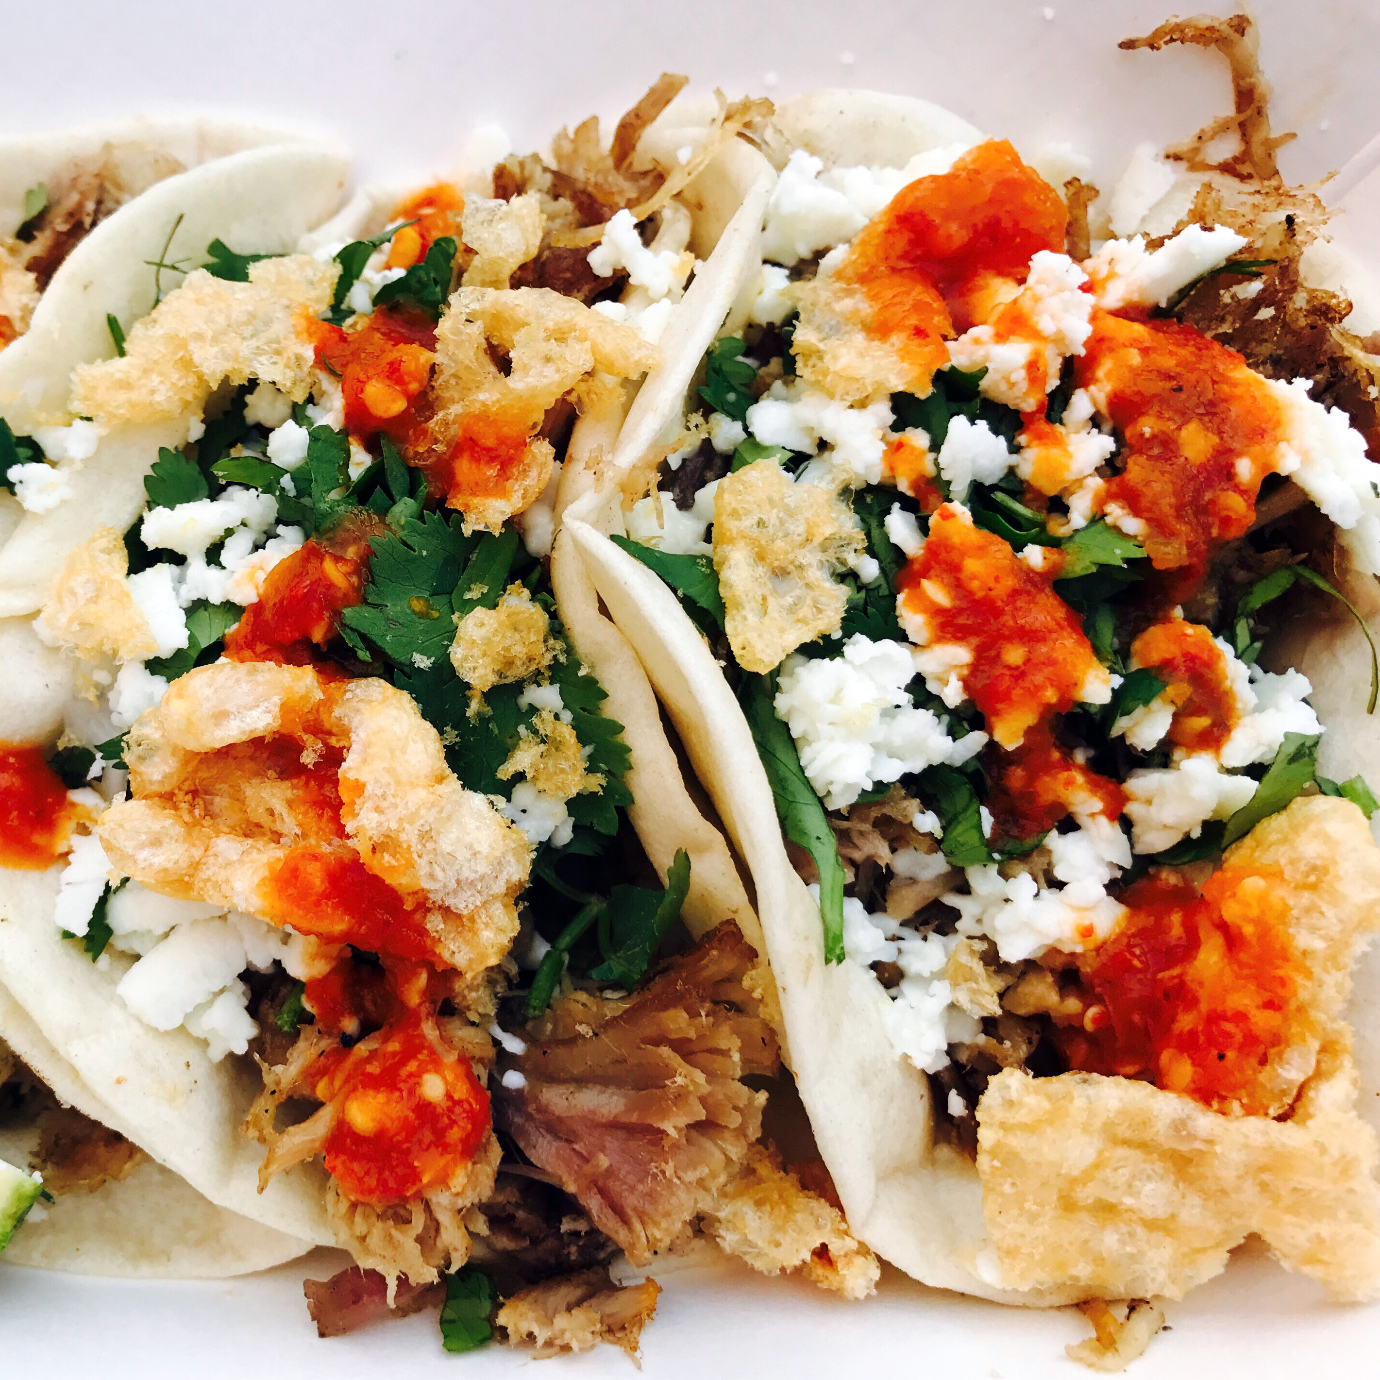
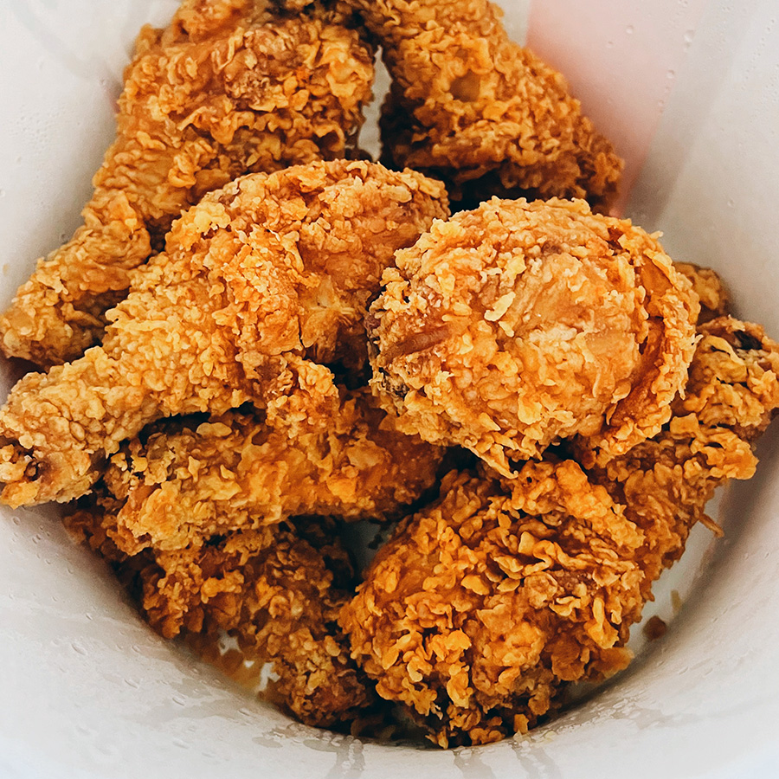
LUNCH
THEMED BUFFET LUNCH
Buffet Require a Minimum of 25 guests: (1) Hour of Service: Priced Per Person
Includes: Freshly Brewed Coffee, Assorted Hot Tea, Iced Tea
SOUTHERN COMFORT | $ 42 per guest
FIESTA | $ 38 per guest
Herb Roasted Chicken Breast~ natural juices
Sliced Herb Marinated Tri-Tip~ port demi-glace
White Cheddar Mac & Cheese
Balsamic Grilled Vegetables
Creamy Dill Potato Salad
Mixed Green Salad~ cucumbers, cherry tomatoes, julienned carrots, basaltic vinaigrette, ranch
Mini Cherry Pies
Chicken Fajitas~ sautéed onion, bell pepper
Pico de gallo, lime, cabbage, sour cream, guacamole, shredded jack cheese and flour tortillas
Cheese Enchiladas~ queso fresco
Mexican Rice
Refried Pinto Beans
Santa Fe Salad~ crisp romaine, roasted corn, tomatoes, black beans, chipotle ranch dressing
Tortilla chips & roasted salsa
Cinnamon churros
TASTE OF ITALY | $ 38 per guest
Penne pasta, roasted red peppers, plum tomatoes, kalamata olives, feta, balsamic vinaigrette
Chicken parmesan~ breaded chicken breast, marinara sauce, mozzarella cheese
Tuscan Bean Soup
Arugula Salad~ crispy prosciutto, shaved parmesan. lemon-oregano vinaigrette
Caprese Salad~ buffalo mozzarella, vine ripened tomatoes, fresh basil, balsamic reduction, olive oil
Garlic bread
Tirimisu
PACIFIC RIM | $ 42 per guest
Lemon Chicken~ sesame seeds
Miso Glazed Atlantic Salmon
Jasmine Rice
Asian Chopped Salad~ napa cabbage, slivered almonds, carrots, cucumbers, scallions, wonton strips, sesame vinaigrette
Green Beans~ soy sauce, ginger, chili flakes, sesame oil
Almond Cookies
All pricing is per person, a 21% taxable service charge and 9.5% sales tax will apply to all food and non-liquor beverage. Pricing ,sales tax and service charge are subject to change

Slide 15
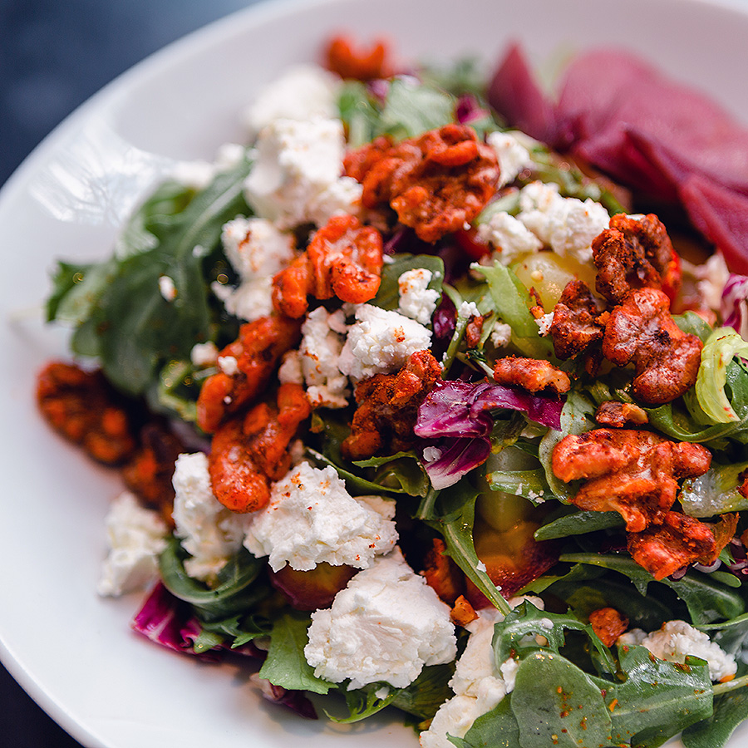
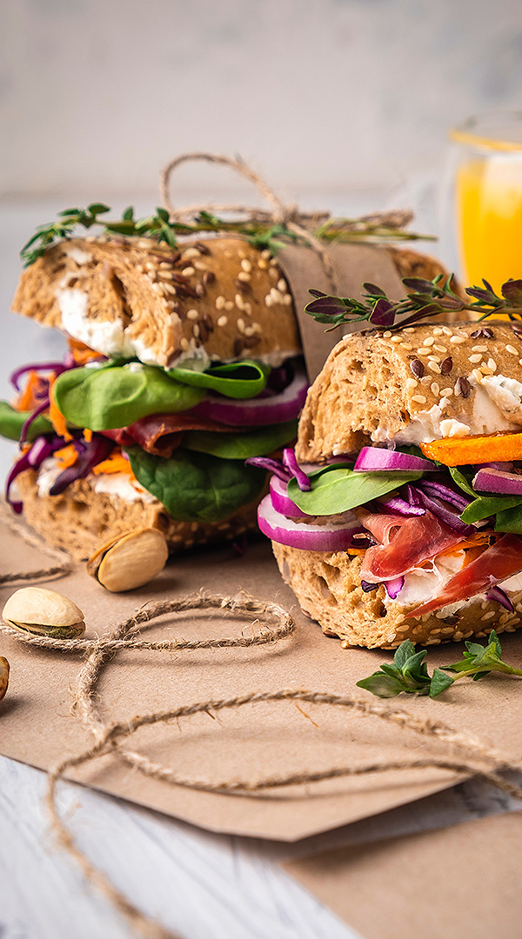
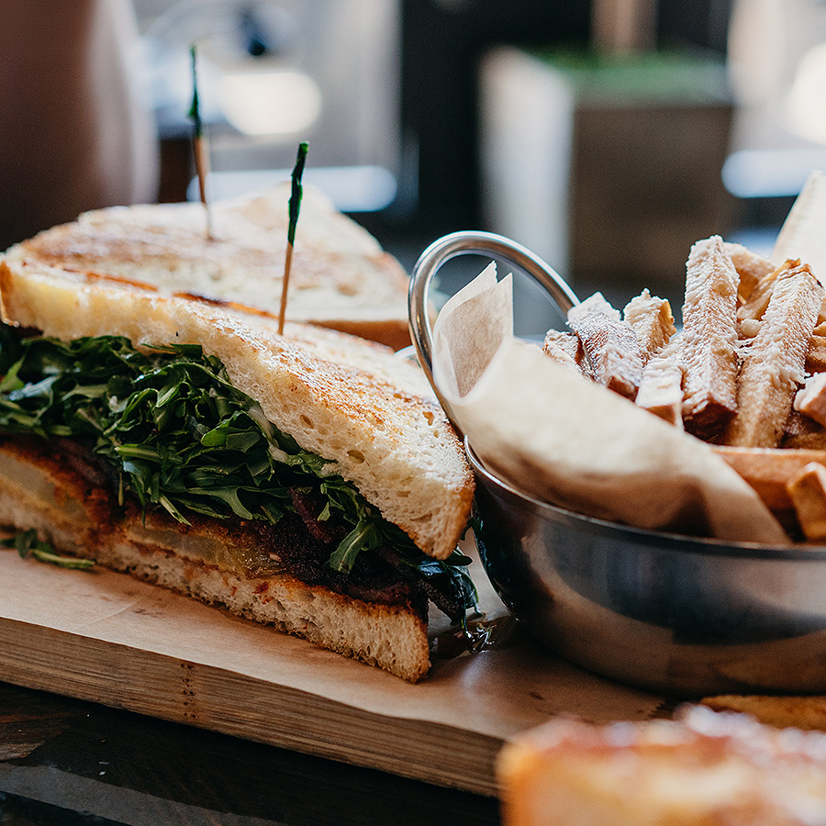
LUNCH
DELI BUFFET
Buffet require a minimum of 25 guests: (1) Hour of Service: Priced Per Person
Includes: Freshly Brewed Coffee, Assorted Hot Tea, Iced Tea, Chefs Selection of Mini Desserts
BUILD YOUR OWN MARKET DELI | $ 35 per guest
Choice of Two Salads:
Classic Caesar~ hearts of romaine, sourdough croutons, shaved parmesan cheese, Caesar dressing
Thai Citrus Salad~ napa cabbage, snow peas, cilantro, mandarin oranges, cashews, toasted sesame vinaigrette
Market Salad~ feta, candied walnuts, cucumber, radish, lemon herb vinaigrette
Mixed Baby Greens~ julienne carrots, cucumber, baby tomatoes, radish, balsamic vinaigrette, ranch
Make Your Own Deli Sandwich
Wheat, White, multigrain and sourdough bread
Black Forrest ham, roasted turkey breast, roast beef
Cheddar, Pepper Jack & Swiss cheeses .
Vine Ripened tomatoes, butter lettuce, red onion, pickle chip
Yellow Mustard, dijon mustard, mayonnaise, herb aioli
All pricing is per person, a 21% taxable service charge and 9.5% sales tax will apply to all food and non-liquor beverage. Pricing ,sales tax and service charge are subject to change

Slide 16
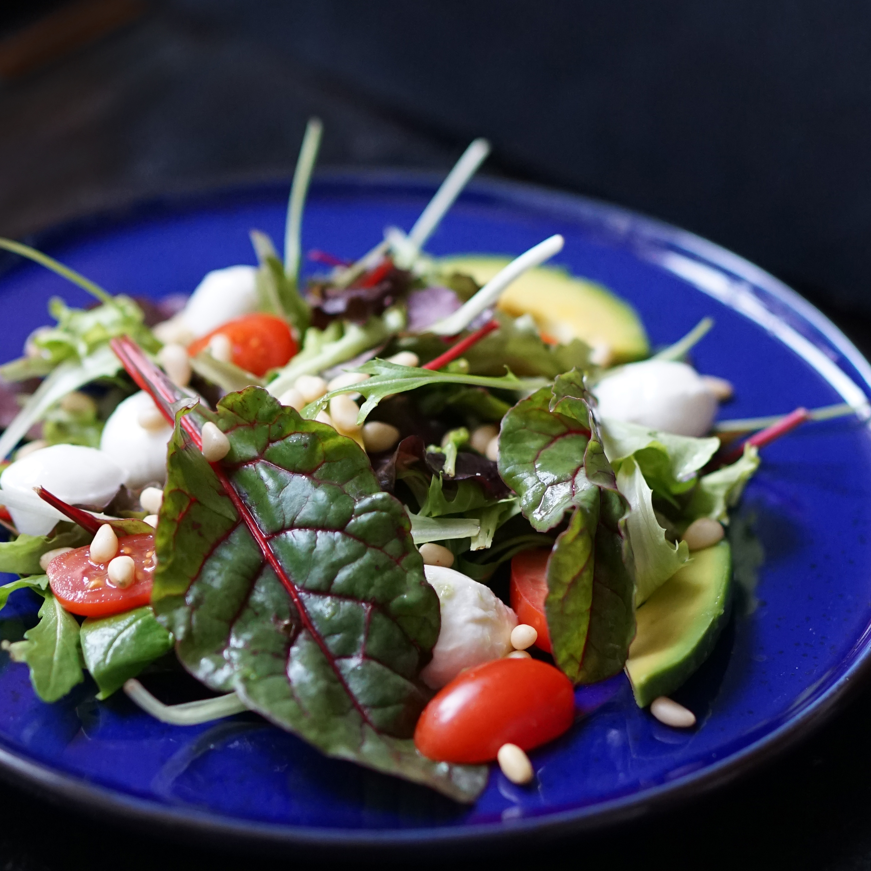
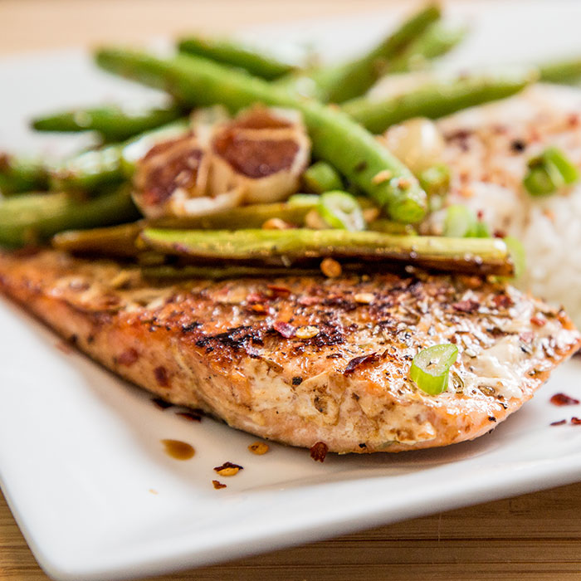
LUNCH
PLATED LUNCH
Plated Luncheons require a minimum of 25 guests: Priced Per Person
Select up to (3) Entrées; (2) Protein, (1) Vegetarian. Entrée counts due 5 days prior to your event
Groups under 25, (1) Entrée Selection
All Plated Luncheons are Two Course and Include:
Starter & Entrée; Freshly Brewed Coffee, Assorted Hot Tea, Iced Tea, Artesian Bread & Butter
COFFEE + BIGELOW TEAS | ORANGE + CRANBERRY JUICE
$38 per guest
STARTERS Choose One:
ENTRÉES Select up to (3) Entrees: (2) Proteins (1) Vegetarian
Seasonal Soup – Chef’s Daily Selection
Classic Caesar~ hearts of romaine, sourdough croutons, shaved parmesan cheese, Caesar dressing
Roasted Beet Salad~ mixed greens, goat cheese, dried cranberries, toasted pecans, lemon vinaigrette
Market Salad~ feta, candied walnuts, cucumber, radish, lemon herb vinaigrette
Mixed Baby Greens~ julienne carrots, cucumber, baby tomatoes, radish, balsamic vinaigrette, ranch
Herb Roasted Chicken Breast~ herb butter, shallots, garlic mashed potatoes, roasted baby carrots, green beans
Sliced Roasted Top Sirloin~ brussels sprouts, creamy polenta
Herb Crusted Salmon~ baby fingerling potatoes, asparagus
Mediterranean Shrimp Pasta~ jumbo shrimp, bowtie pasta, spinach, mushroom, tomato, pesto crème sauce
Chicken Picatta~ lemon caper beurre blance, mashed potatoes, roasted broccoli
Blackened Mahi Mahi~ mango & tomatillo salsa, wild rice
Grilled Tofu~ seasonal vegetables
Grilled Vegetable Risotto~ squash, zucchini, roasted asparagus, baby carrots
DESSERTS Choose One:
(optional dessert add on, $8 per person)
Crème Brulee~ fresh berries
New York Cheesecake~ raspberry coulis, fresh raspberries
Chocolate Cake~ caramel sauce, whipped cream
All pricing is per person, a 21% taxable service charge and 9.5% sales tax will apply to all food and non-liquor beverage. Pricing ,sales tax and service charge are subject to change

Slide 17
CATERING AT CROWNE PLAZA
RECEPTIONS

Slide 18
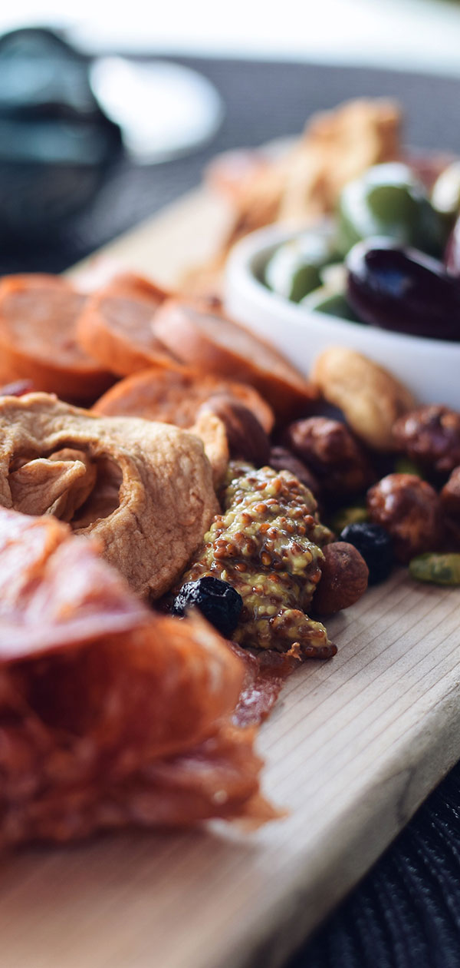
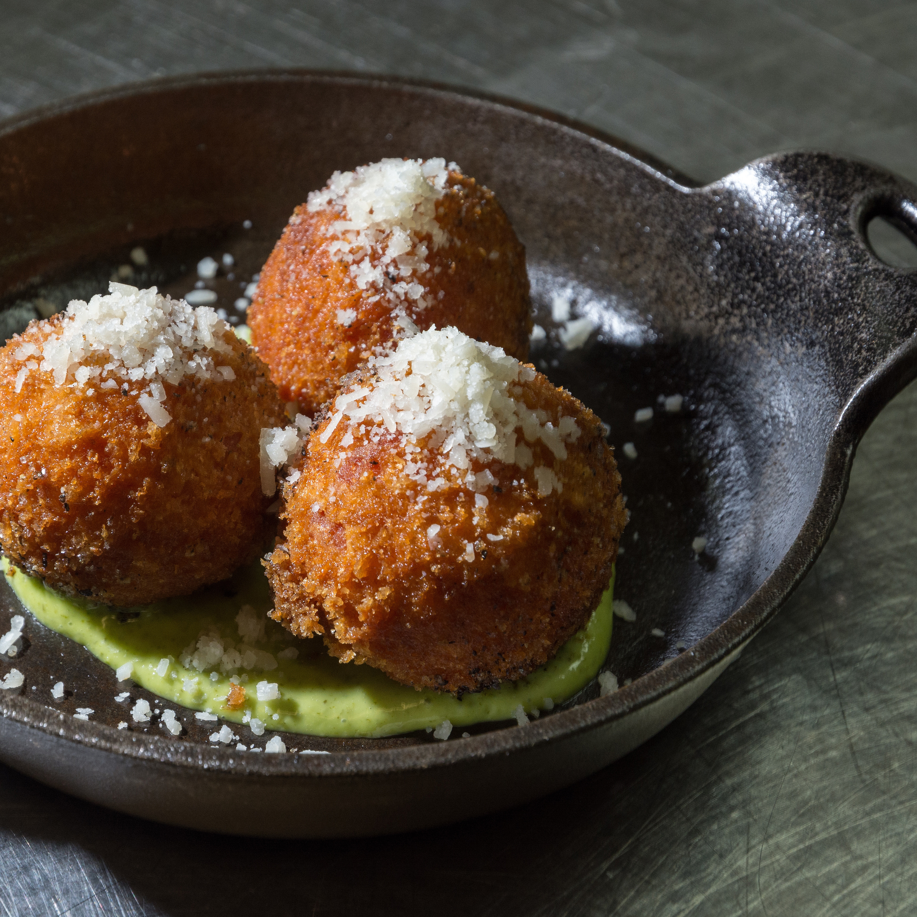
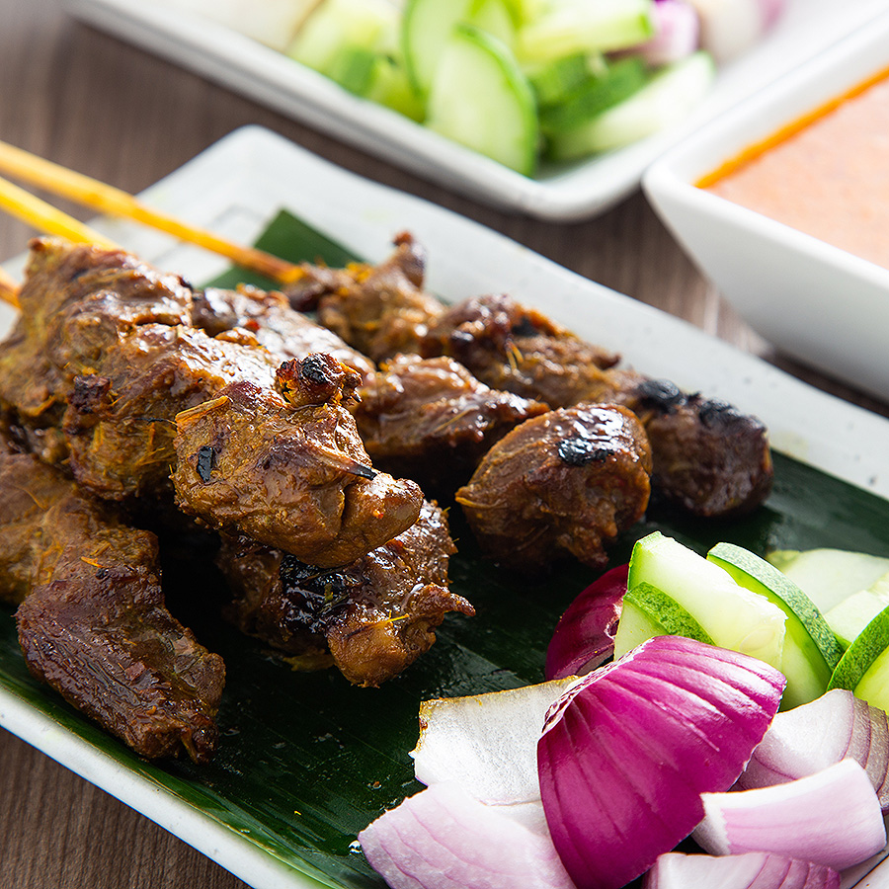
RECEPTIONS
DISPLAYS
Hors d’oeuvre Displays require a minimum of 25 guests; Priced Per Person
Hors d’oeuvre Displays are an add on to tray passed hors d’oeuvres, meal service or stations
CHEESE & CHARCUTERIE | $ 20 per guest
Domestic and imported cheeses, cured meats, fig jam, assorted dried fruit, candied pecans and toasted nuts, cornichons, caper berries, french baguette, gourmet crackers
GRILLED VEGETABLE CRUDITE | $ 10 per guest
Assorted seasonal grilled vegetables, buttermilk ranch, garlic herb aioli
MEDITERRANEAN SPREADS | $ 14 per guest
Assorted hummus, olive tapenade, kalamata olives, vegetable crudité, pita bread
ANTIPASTO DISPLAY | $ 18 per guest
Kalamata olives, artichoke, salami, mushrooms, pepperchinis, fresh mozzarella, pickled vegetables, focaccia crostini, Italian breadsticks
FRESH FRUIT & BERRIES | $ 9 per guest
Assorted sliced seasonal fruit, berries, honey yogurt dip
SPINACH DIP & ARTICHOKE DIP | $10 per guest
French baguette
CEVICHE | $20 per guest
Chef selection seafood ceviche, tostada, tapatio, roasted habanero salsa
All pricing is per person, a 21% taxable service charge and 9.5% sales tax will apply to all food and non-liquor beverage. Pricing ,sales tax and service charge are subject to change

Slide 19
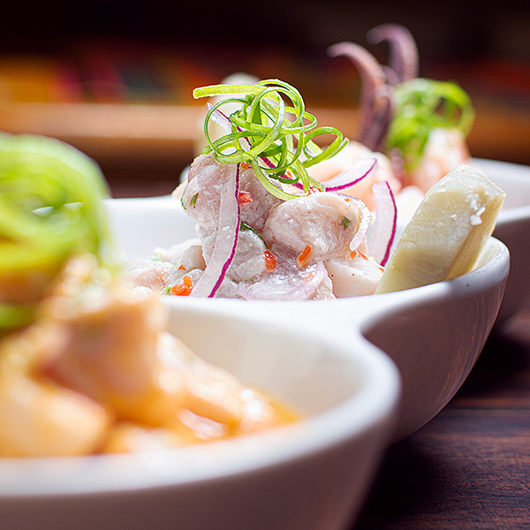
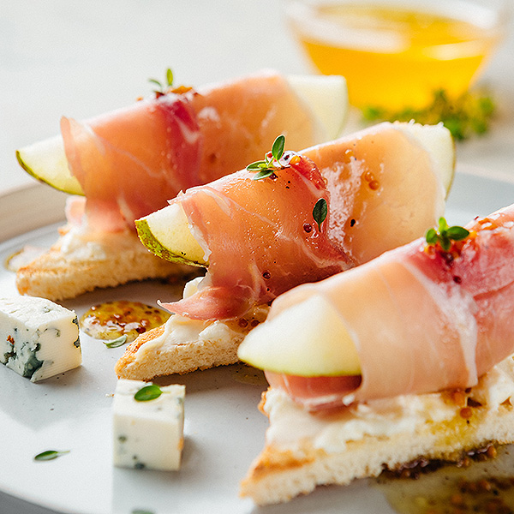
RECEPTIONS
TRAY PASSED HORS D’OEUVRES
Tray Passed Hors d’oeuvres require a minimum of 25 guests; Priced Per Person
Tray Passed Hors d’oeuvres are an add on to displays, meal service or stations
COLD
Caprese Skewers~ baby heirloom tomatoes, basil, fresh buffalo mozzarella, balsamic glaze
Bruschetta~ toasted crostini, basil, balsamic reduction
Seared Ahi Tuna~ wasabi glaze, wonton crisp
Seafood Ceviche~ chef’s choice ceviche, tortilla chip
Ahi Poke Tacos~ wasabi guacamole, green onions, sesame oil, creamy sriracha aioli, wonton taco
Prosciutto Wrapped Pear~ olive oil, pepper
Jumbo Shrimp Cocktail~ cocktail sauce
Gorgonzola Raisin Bruschetta~ arugula
Antipasto Skewers~ salami, mozzarella, roasted pepper, artichoke, olive
HOT
Coconut Shrimp~ sweet chili sauce
Bacon Wrapped Date~ blue cheese
Beef or Chicken Satay~ peanut sauce
Vegetarian or Pork Pot Stickers~ ponzu & sweet chili sauce
Triple Cheese Quesadilla~ charred salsa
Beef Sliders~ brioche bun, bacon, cheddar, garlic aioli
Mini Crab Cake~ ramoulade sauce
Vegetable Spring Roll~ soy ginger sauce
Beef & Chicken Empanades
$20 per guest for three selections for a thirty-minute reception
$28 per guest for four selections for a one-hour reception
$30 per guest for five selections for a one-hour reception
**Extended time available upon request at an additional charge**
All pricing is per person, a 21% taxable service charge and 9.5% sales tax will apply to all food and non-liquor beverage. Pricing ,sales tax and service charge are subject to change

Slide 20
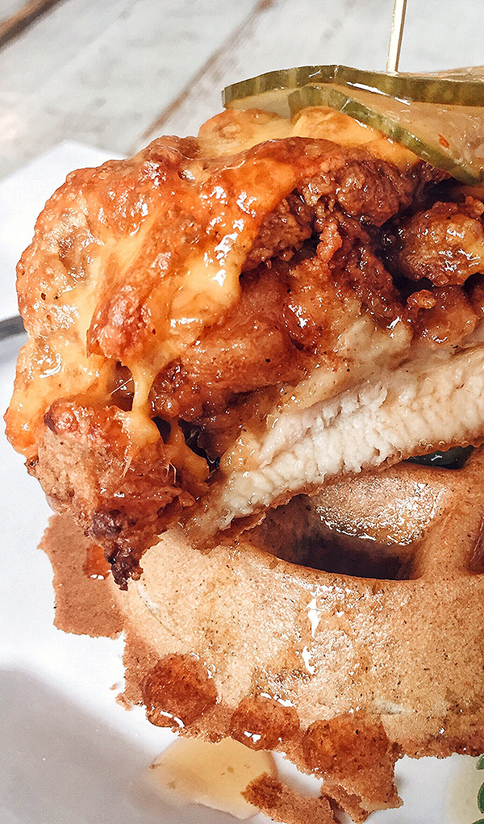
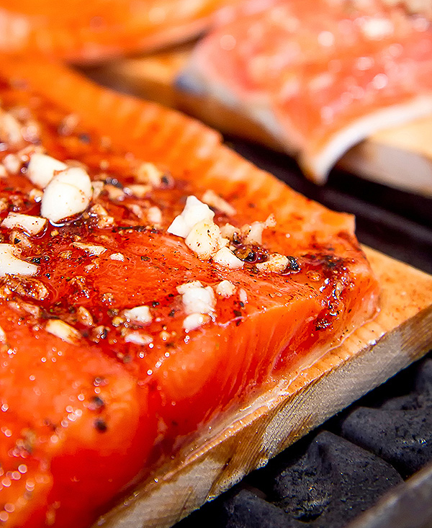
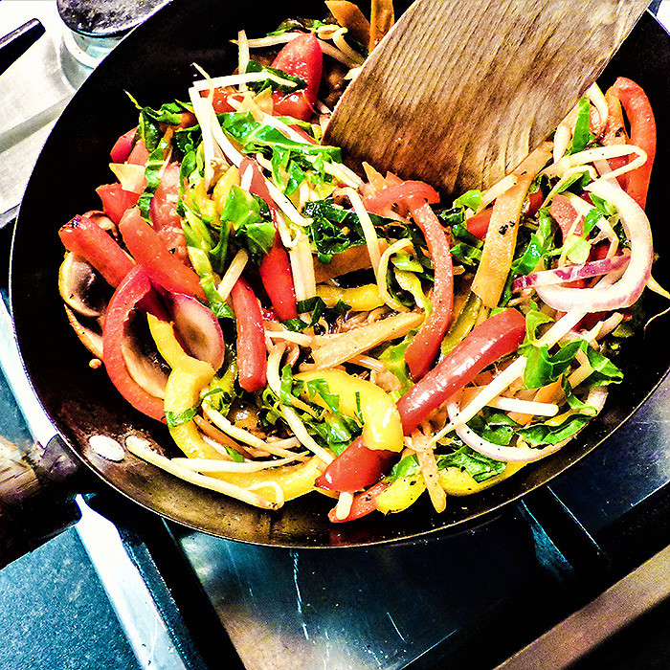
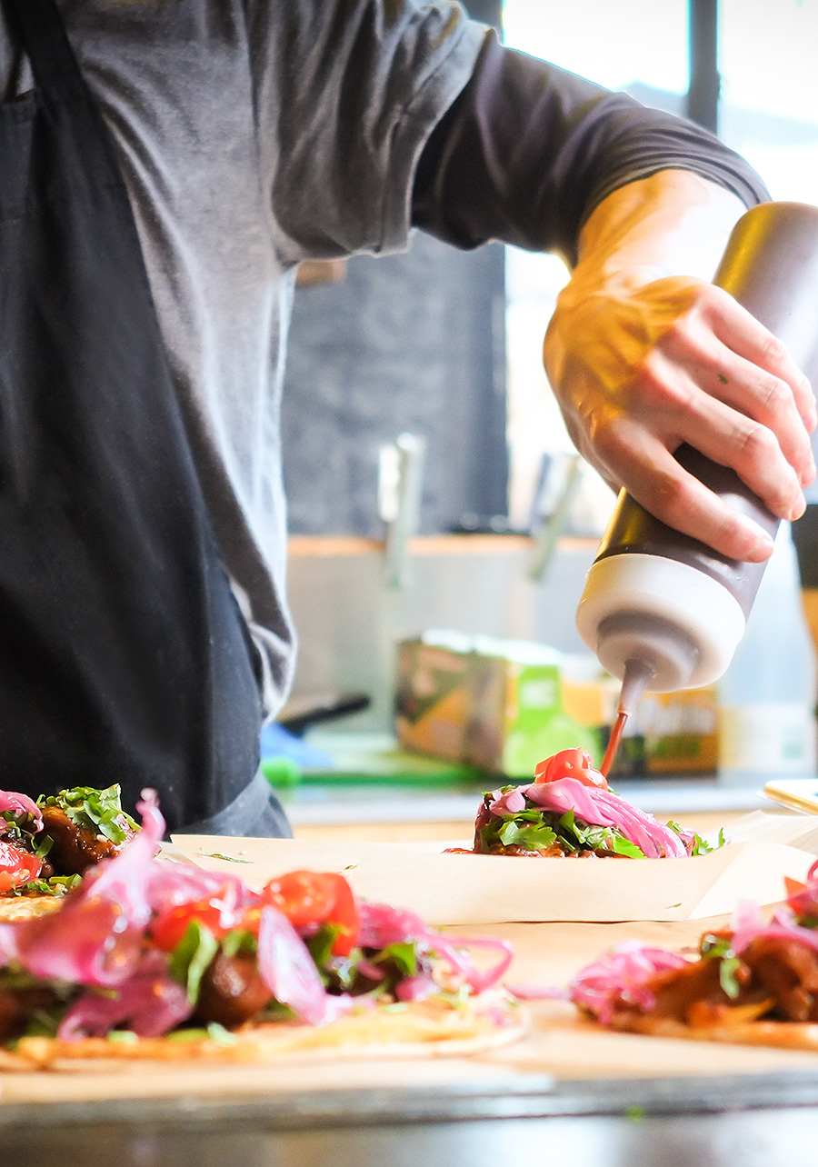
RECEPTIONS
STATIONS
Reception Stations require a minimum of 25 guests; Priced Per Person
Stations are an add on to tray passed hors d’oeuvres, displays, combination stations or meal service
SLIDERS & FRIES | $ 38 per guest
SALAD STATION | $ 25 per guest
Choice of Two:
BBQ pork, beef, veggie & fried chicken sliders
Slider buns
Lettuce, tomato, red onion, pickles
Choice of Two:
Truffle Fries, garlic fries, sweet potato fries, tater tots
Assorted sauces; ketchup, garlic aioli, buttermilk ranch, sriracha mayo
Choice of Three Salads:
Classic Caesar~ hearts of romaine, sourdough croutons, shaved parmesan cheese, Caesar dressing
Thai Citrus Salad~ napa cabbage, snow peas, cilantro, mandarin oranges, cashews, toasted sesame vinaigrette
Roasted Beet Salad~ mixed greens, goat cheese, dried cranberries, toasted pecans, lemon vinaigrette
Market Salad~ feta, candied walnuts, cucumber, radish, lemon herb vinaigrette
Mixed Baby Greens~ julienne carrots, cucumber, baby tomatoes, radish, balsamic vinaigrette, ranch
TACO TRUCK | $ 34 per guest
Carnitas
Carne asada
Grilled chicken
Spanish rice
Refried beans
Corn & flour tortillas
CARVING STATIONS
Pico de gallo, salsa verde, guacamole, cotija cheese, jack cheese, cilantro, onions and shredded cabbage
*Requires a chef attendant ($150 per attendant, per station)
Includes: Artesian Bread and Butter
BOURBON GLAZED HAM | $ 13 per guest
BYO PASTA STATION | $ 35 per guest
Apple compote, grain mustard
Penne, tortellini, fettuccini
Marinara, alfredo, pesto
Grilled chicken, italian sausage
Mushrooms, spinach, sundried tomatoes, bell peppers
Crushed pepper, parmesan cheese
*Requires a chef attendant ($150 per attendant)
HOUSE ROASTED TURKEY | $ 15 per guest
Black pepper pan gravy, cranberry compote
PRIME RIB | $ 25 per guest
Creamy & raw horseradish, au jus
CEDAR PLANK SALMON | $ 23 per guest
DESSERT & COFFEE | $ 28 per guest
Citrus glaze, lemon aioli
Freshly Brewed Regular and Decaf Coffee
Assorted Hot Teas
Chef’s selection of mini desserts
ROASTED BEEF TENDERLOIN | $ 25 per guest
Wild mushroom sauté, bernaise sauce
All pricing is per person, a 21% taxable service charge and 9.5% sales tax will apply to all food and non-liquor beverage. Pricing ,sales tax and service charge are subject to change

Slide 21
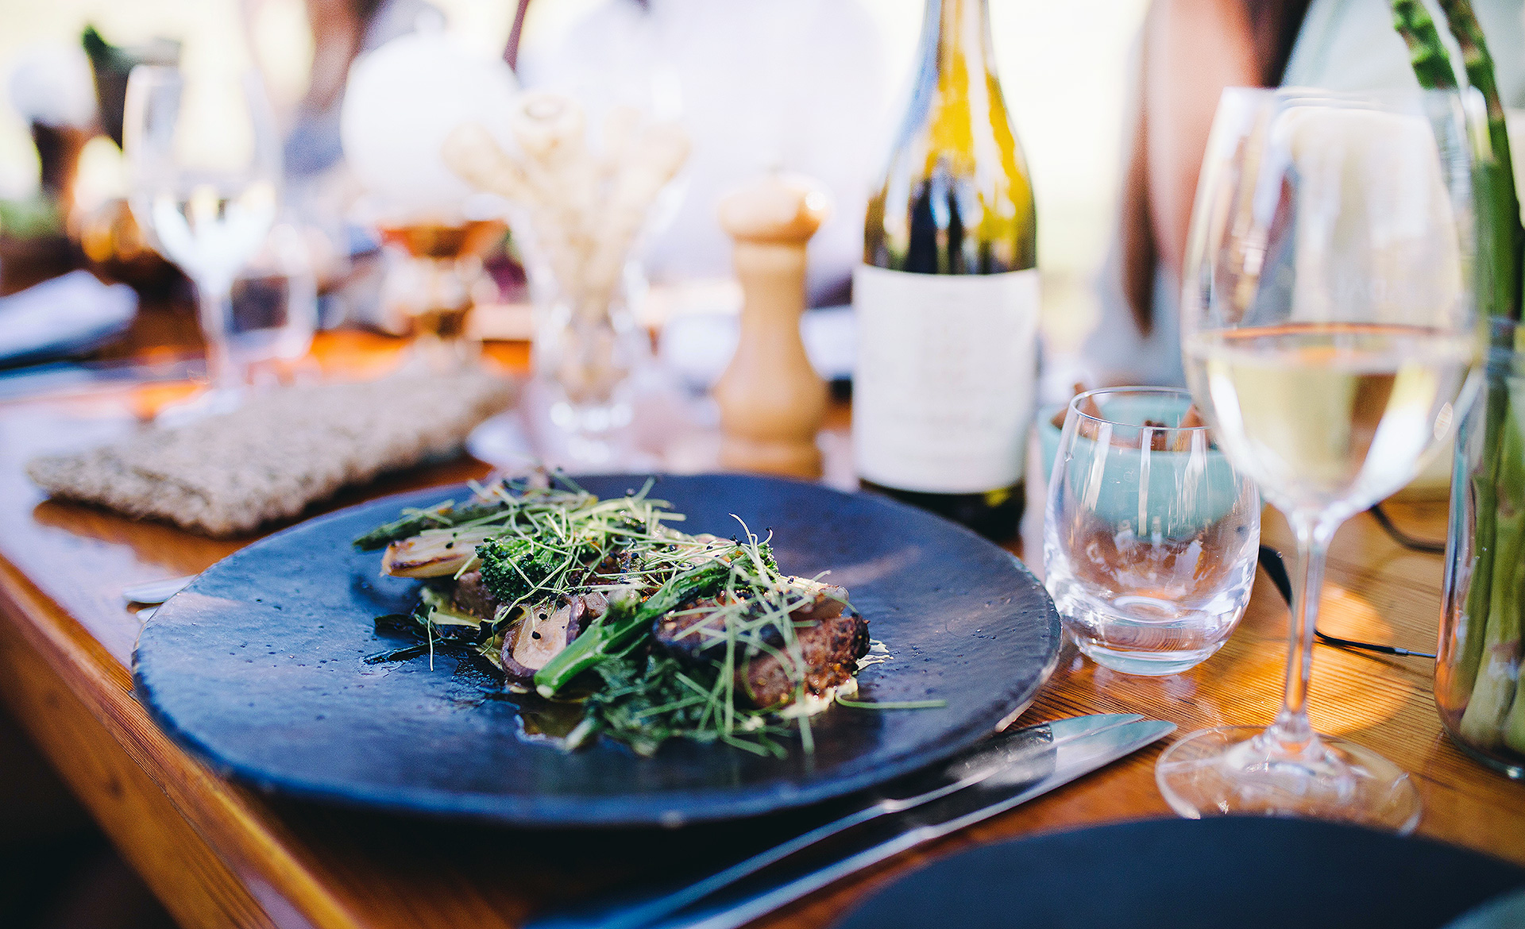
CATERING AT CROWNE PLAZA
DINNER

Slide 22
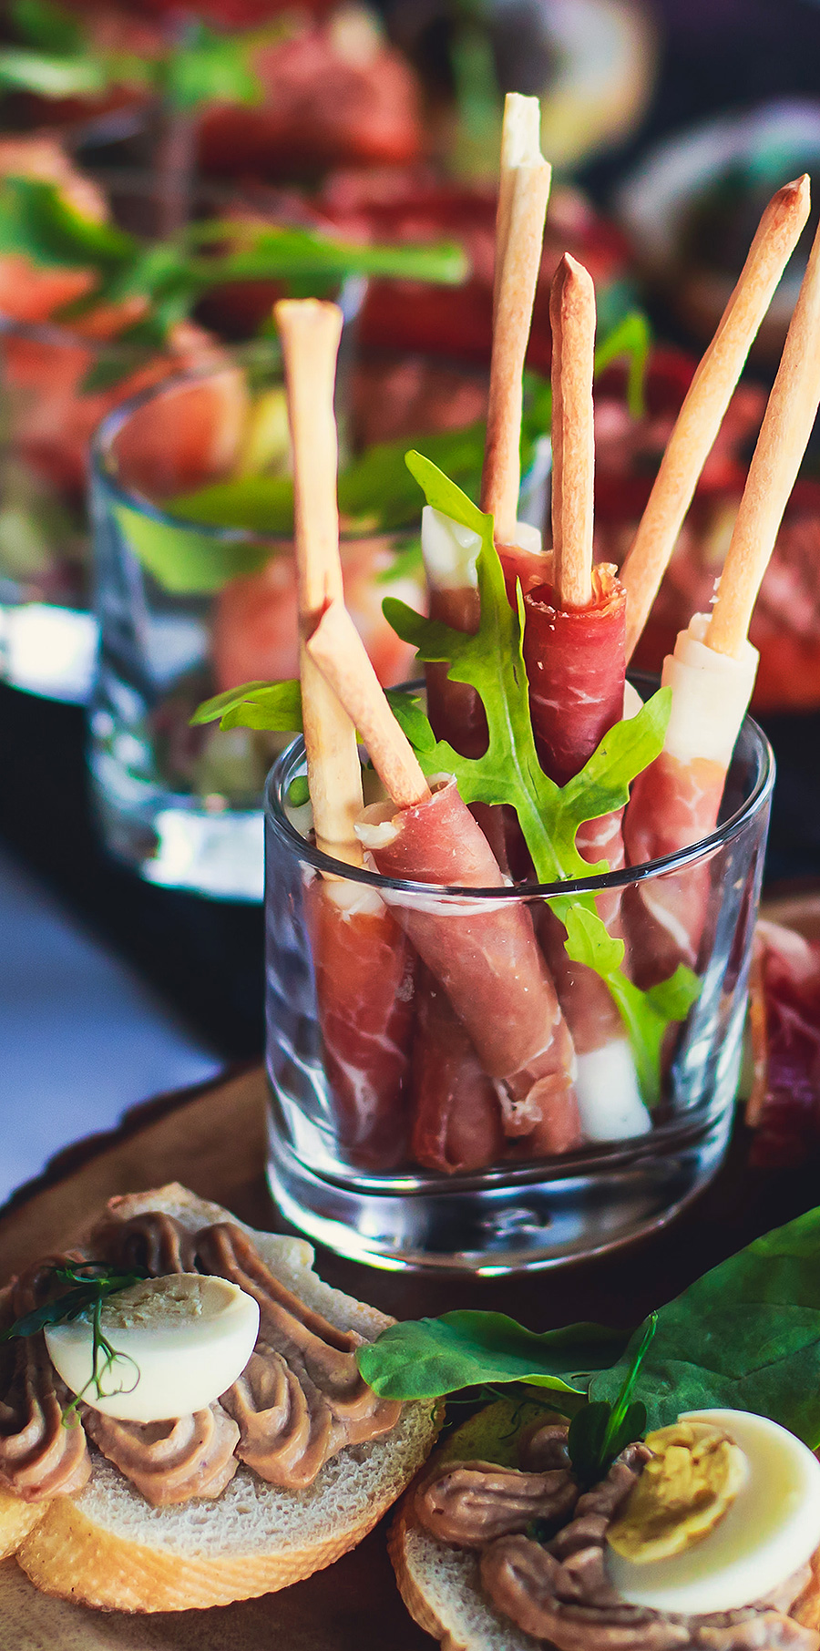
DINNER
COFFEE + BIGELOW TEAS | ORANGE + CRANBERRY JUICE
DINNER BUFFET
Buffet require a minimum of 25 guests: (1) Hour of Service: Priced Per Person
Includes: Freshly Brewed Coffee, Assorted Hot Tea, Iced Tea
Artesian Bread & Butter, Chefs Selection of Mini Desserts
THE POINT FERMIN
Choice of Entrees:
Choice of Two Starters:
Soup Du Jour
Citrus Roasted Beet Salad~ arugula, candied pecans, goat cheese, white balsamic vinaigrette
Classic Caesar~ hearts of romaine, sourdough croutons, shaved parmesan cheese, Caesar dressing
Thai Citrus Salad~ napa cabbage, snow peas, cilantro, mandarin oranges, cashews, toasted sesame vinaigrette
Market Salad~ feta, candied walnuts, cucumber, radish, lemon herb vinaigrette
Mixed Baby Greens~ julienne carrots, cucumber, baby tomatoes, radish, balsamic vinaigrette, ranch
Eggplant Lasagna~ roasted tomato, ricotta, tomato basil
Hickory-Smoked Pork Loin~ mustard BBQ, golden pineapple salsa
Pan-Seared Seabass~ orange beurre blanc, balsamic reduction
Pan-Roasted Salmon~ butter braised radishes, salsa verde
Roasted Beef Tenderloin~ red wine demi-glace
Roasted Breast of Chicken~ creamy garlic sauce
Braised Short Ribs~ bordelaise sauce, crispy onions
Choice of One Entrée – $65 per guest
Choice of Two Entrées – $75 per guest
MEAL ADD-ONS:
Add third starter: +$8 per guest
Add third side: +$8 per guest
Add third entrée: +15 per guest
Choice of Two Sides:
Sweet potato gratin
Roasted seasonal vegetables
Grilled asparagus
Roasted fingerling potatoes
Yukon gold mashed potatoes
Roasted brussels sprouts
Israeli couscous
Wild rice
All pricing is per person, a 21% taxable service charge and 9.5% sales tax will apply to all food and non-liquor beverage. Pricing ,sales tax and service charge are subject to change

Slide 23
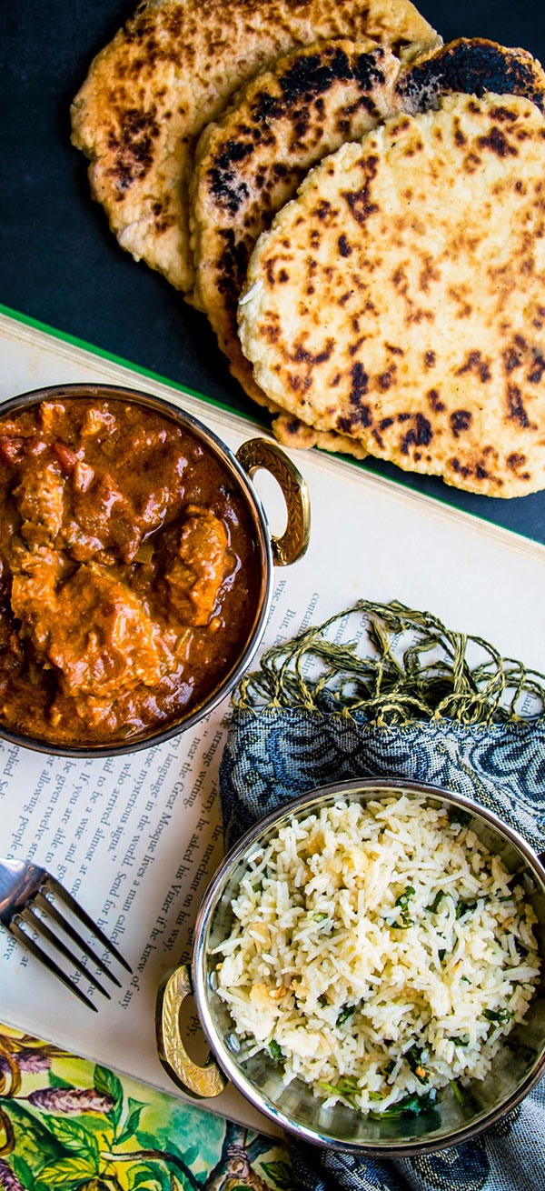
DINNER
THEMED DINNER BUFFET
COFFEE + BIGELOW TEAS | ORANGE + CRANBERRY JUICE
Buffet require a minimum of 25 guests: (1) Hour of Service: Priced Per Person
Includes: Freshly Brewed Coffee, Assorted Hot Tea, Iced Tea
PACIFIC RIM | $ 60 per guest
Lemon Chicken~ sesame seeds
Miso Glazed Atlantic Salmon
Lo Mein Noodles~ water chestnuts, scallions, beansprouts
Jasmine Rice
Vegetable Dumplings~ sweet chili sauce
Green Beans~ soy sauce, ginger, chili flakes, sesame oil
Asian Chopped Salad~ napa cabbage, slivered almonds, carrots, cucumbers, scallions, wonton strips, sesame vinaigrette
Almond Cookies
TASTE OF ITALY | $ 70 per guest
Chicken Marsala~ wild mushroom marsala sauce
Parmesan & Rosemary Crusted Beef Tenderloin~ chianti wine sauce
Mascarpone Whipped Potatoes
Potato Gnocchi~ basil pesto
Charred broccolini
Garlic green beans
Tuscan bean soup
Caprese Salad~ buffalo mozzarella, vine ripened tomatoes, fresh basil, balsamic reduction, olive oil
Arugula Salad~ crispy prosciutto, shaved parmesan. lemon-oregano vinaigrette
Mini Cannoli's and Tiramisu
FIESTA | $ 65 per guest
Build Your Own Tacos
- Carnitas, Carne Asada, Shredded Chicken
- Corn & Flour Tortillas
Cheese Enchiladas~ enchilada sauce
Roasted salsa, pico de gallo, lime, cabbage, cojita cheese, sour cream, guacamole, shredded jack cheese
Mexican Rice
Refried Pinto Beans
Vegetarian Tortilla Soup~ sour cream tortilla chips
Santa Fe Salad~ crisp romaine, roasted corn, tomatoes, black beans, chipotle ranch dressing
Tortilla chips & house made salsa
Mini Caramel Flan and Cinnamon Churros
All pricing is per person, a 21% taxable service charge and 9.5% sales tax will apply to all food and non-liquor beverage. Pricing ,sales tax and service charge are subject to change

Slide 24
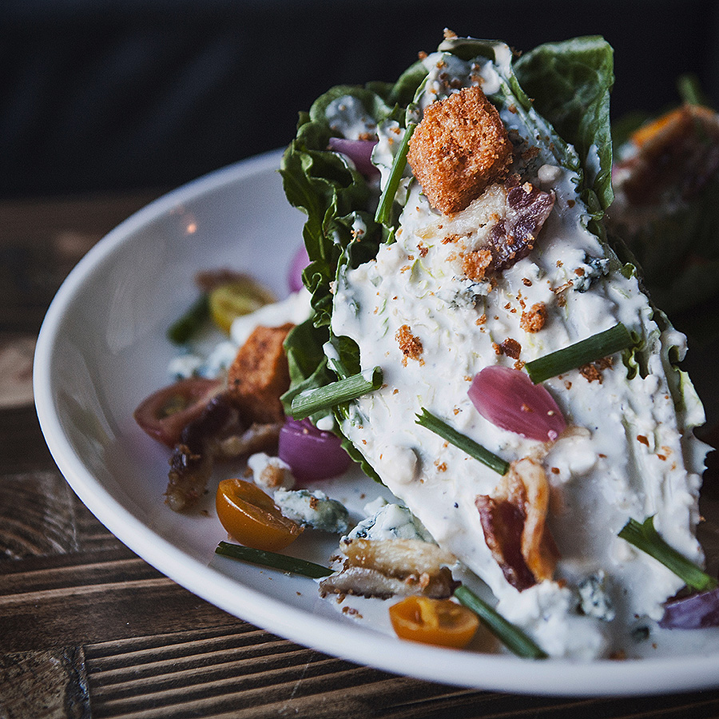
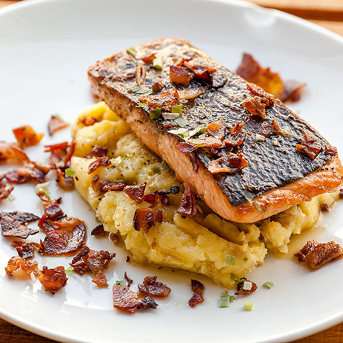
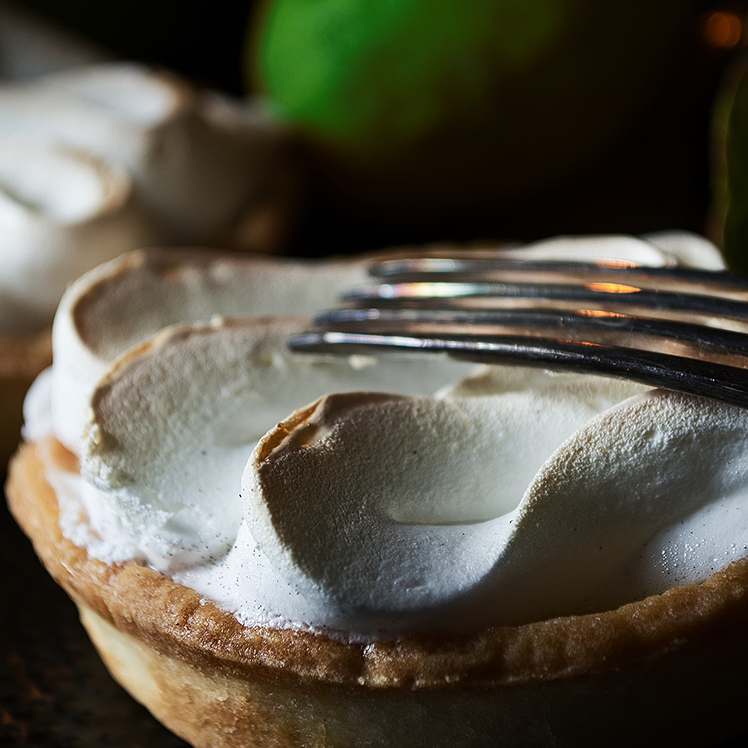
DINNER
PLATED DINNER
Plated Dinners require a minimum of 25 guests: Price Listed Per Entrée
Select up to (3) Entrées; (2) Protein (1) Vegetarian; Entrée counts due 5 days prior to your event
Additional $150 Fee Applies to all Groups Less Than 25 People, No Less Than 15
All Plated Dinners are Three Course and Include:
Starter, Entrée & Dessert; Freshly Brewed Coffee, Assorted Hot Tea, Iced Tea, Artesian Bread & Butter
STARTERS Choose One
ENTRÉES Select up to (3) Entrees: (2) Proteins (1) Vegetarian
Soup Du Jour~ chef’s daily selection
Classic Caesar~ hearts of romaine, sourdough croutons, shaved parmesan cheese, Caesar dressing
Arugula & Roasted Beet Salad~ goat cheese, red onion, sherry vinegar and watercress
Market Salad~ feta, candied walnuts, cucumber, radish, lemon herb vinaigrette
Mixed Baby Greens~ julienne carrots, cucumber, baby tomatoes, radish, balsamic vinaigrette, ranch
Traditional Wedge Salad~ tomatoes, blue cheese, bacon crumbles, blue cheese dressing
Baby Kale & Red Quinoa Salad~ honeycrisp apples, walnuts, champagne vinaigrette
Italian Burrata~ creamy burrata, heirloom tomatoes, basil pesto, ciabatta bread
Grilled New York Strip~ twice baked potato, sautéed garlic broccollini $64++ p/p
Herb Crusted Salmon~ baby fingerling potatoes, asparagus $60++ p/p
Mediterranean Shrimp Pasta~ jumbo shrimp, bowtie pasta, spinach, mushroom, tomato, pesto crème sauce $55++ p/p
Chicken Picatta~ lemon caper beurre blanc, mashed potatoes, roasted broccoli $56 ++ p/p
Herb Roasted Chicken Breast~ mushrooms, fontina cheese, smashed red bliss potatoes, roasted asparagus, madeira wine sauce $56++ p/p
Butternut Squash Ravioli~ artichoke beurre blanc, truffle oil $52++ p/p
Eggplant lasagna~ roasted tomato, ricotta, basil $52++ p/p
Grilled Vegetable Risotto~ squash, zucchini, roasted asparagus, baby carrots $52++ p/p
Items below require a 50 guest minimum
Braised Short Ribs~ parmesan polenta, roasted root vegetables, red wine demi glace, crispy shallots
$60++ p/p
Grilled Colorado Lamb Chops~ sweet potato gratin, caramelized fennel-ginger glazed carrots, red wine jus $68++ p/p
Blackened Mahi Mahi~ mango & tomatillo salsa, wild rice $60++ p/p
DESSERTS Choose One
Crème Brulee~ fresh berries
New York Cheesecake~ raspberry coulis, berries
Chocolate Cake~ caramel sauce, whipped cream
Key Lime Tart
Chef’s Dessert Trio
All pricing is per person, a 21% taxable service charge and 9.5% sales tax will apply to all food and non-liquor beverage. Pricing ,sales tax and service charge are subject to change

Slide 25
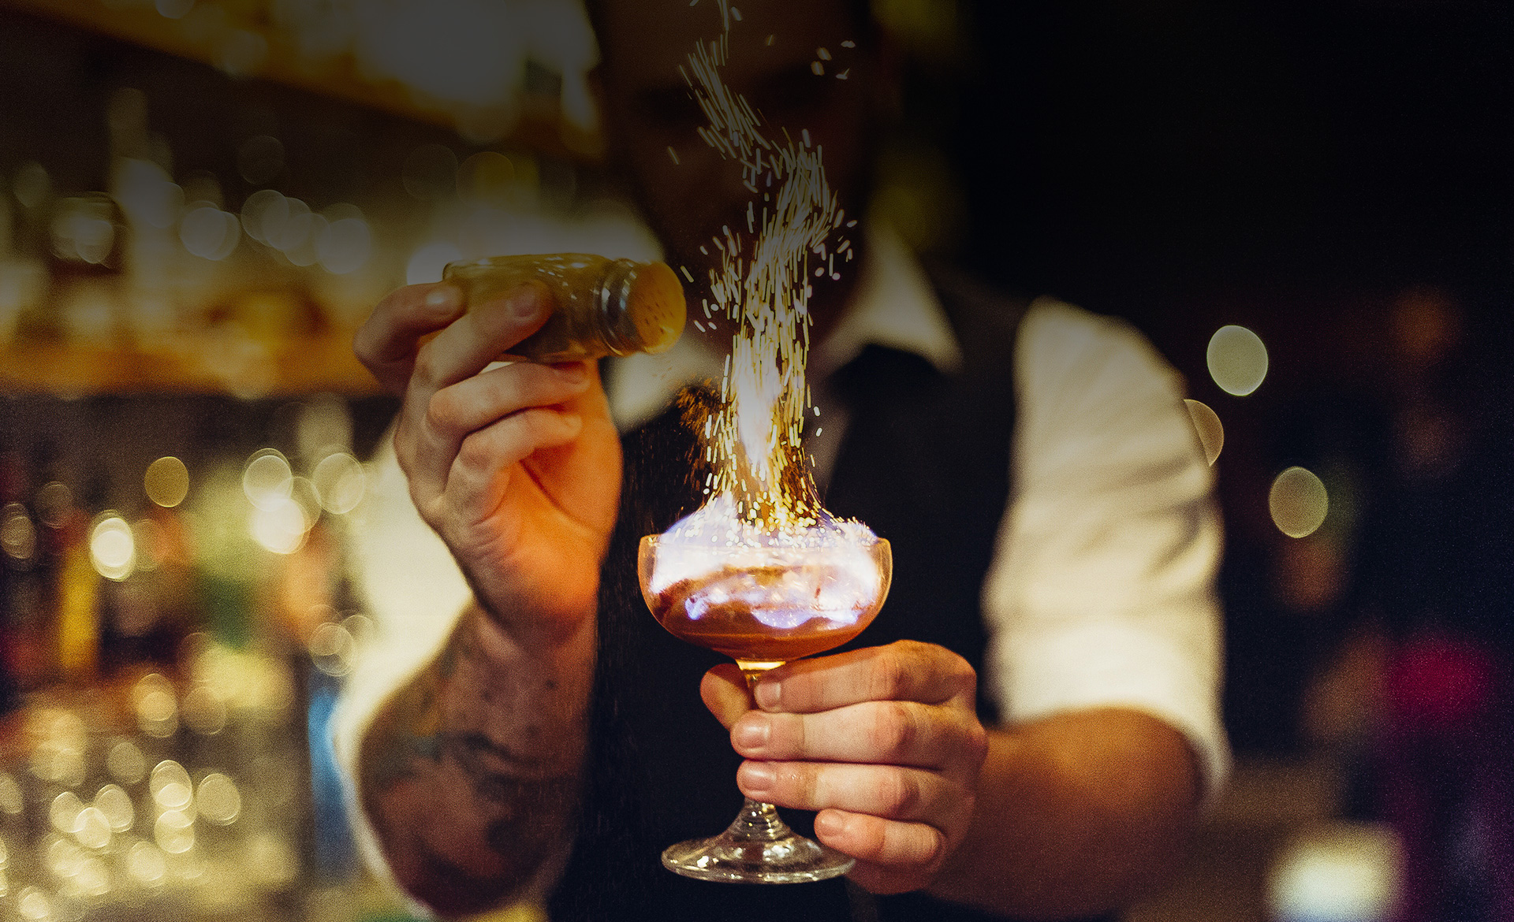
CATERING AT CROWNE PLAZA
BEVERAGE

Slide 26
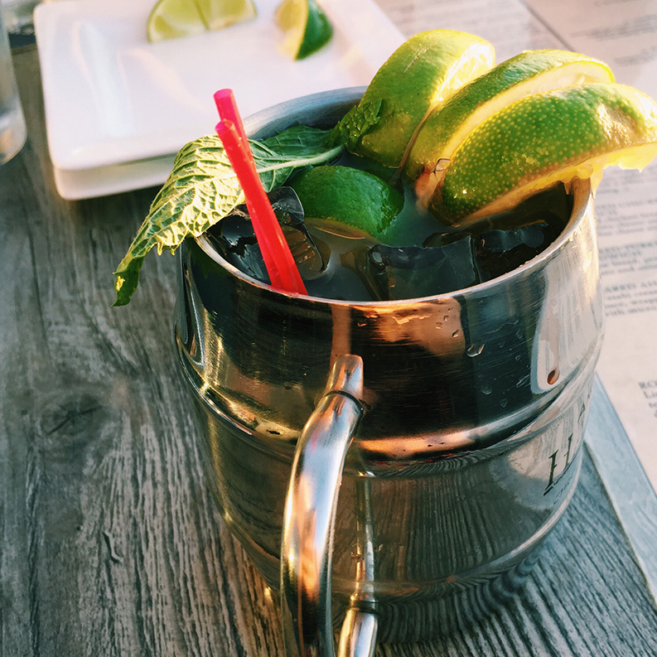
BEVERAGE
PACKAGE BAR
1-HOUR HOSTED
PREMIUM BRANDS
1-HOUR HOSTED
ULTRA PREMIUM BRANDS
New Amsterdam Vodka
Bombay Original Gin
Four Roses Bourbon
Cruzan Aged Light Rum
Bushmills Whisky
Corazon Tequila Blanco
Remy Martin 1738 Accord Royal Cognac
The Famous Grouse Scotch
Domestic and Imported Beer
Premium Wines
Assorted Soft Drinks
Bottled Still and Sparkling Water
Absolute Vodka, Titos
Bombay Sapphire Gin
Maker’s Mark Bourbon
Ron Zacapa 23 Solara Rum
Jack Daniel’s Whiskey, Crown Royal Whiskey
Don Julio Tequila
Courvoisier VSOP Cognac
Johnnie Walker Black Scotch
Domestic and Imported Beer
Ultra-Premium Wines
Assorted Soft Drinks
Bottled Still and Sparkling Water
$25 per guest first hour
$10 per guest each additional hour
$28 per guest first hour
$13 per guest each additional hour
1-HOUR HOSTED
BEER & WINE
5-HOUR HOSTED
NON-ALCOLHOLIC BEVERAGES
House Wine
Domestic and Imported Beer
Bottled Still & Sparkling Water
Soft Drinks, Juices
Soft Drinks
Juices
Bottled Still & Sparkling Water
$18 per guest

Slide 27
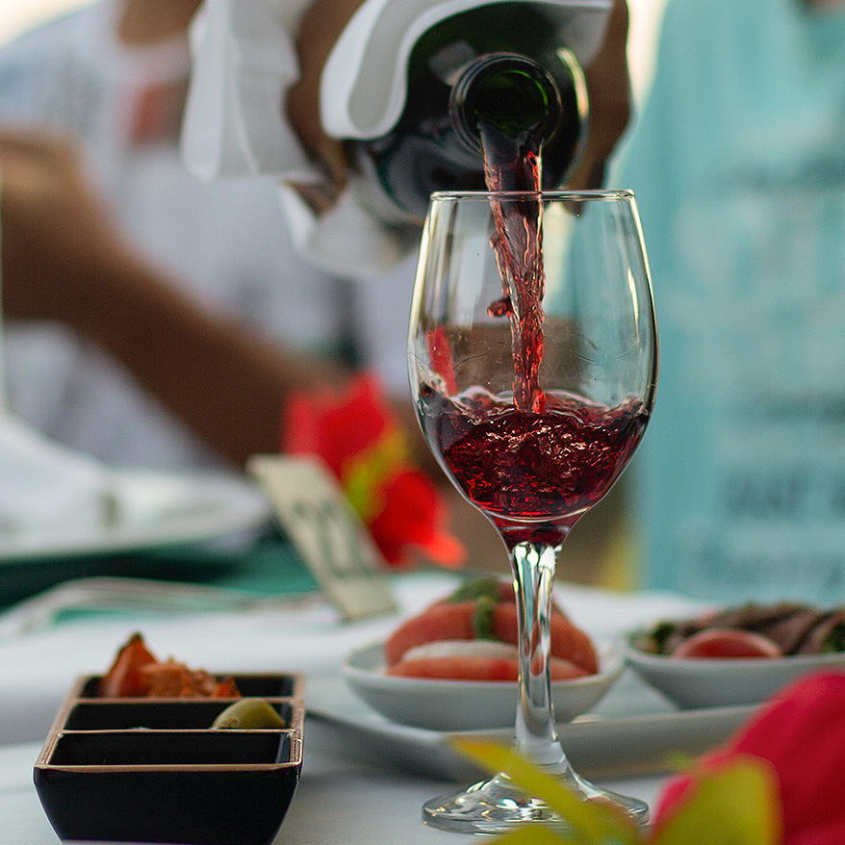
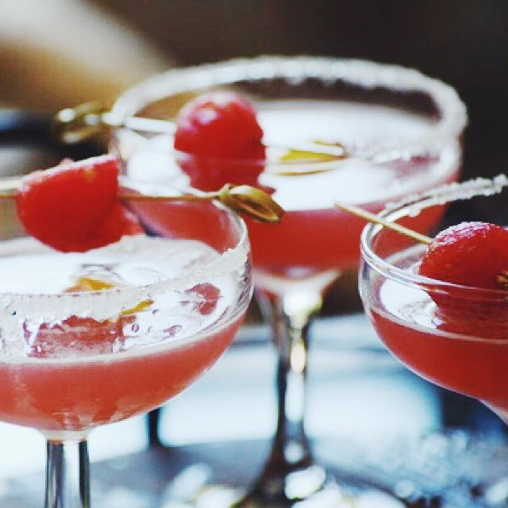
BEVERAGE
CONSUMPTION BAR
Hosted by Client, All Drinks Added to Final Bill
PREMIUM BRANDS | $10 p/drink
DOMESTIC BEER | $7 p/drink
New Amsterdam Vodka
Bombay Original Gin
Four Roses Bourbon
Cruzan Aged Light Rum
Bushmills Whisky
Corazon Tequila Blanco
Remy Martin 1738 Accord Royal Cognac
The Famous Grouse Scotch
Bud Light, Miller Light, Coors Light
IMPORTED/CRAFT BEER | $8 p/drink
Heineken, Amstel Light, Modelo Especial, Lagunitas IPA, Pacifico, Blue Moon Belgian White, Samuel Adams Boston Lager, Angry Orchard Hard Cider, White Claw Hard Seltzer
PREMIUM WINE | $9 p/glass
ULTRA PREMIUM BRANDS | $12 p/drink
30 Degree Chardonnay, Cabernet Sauvignon; La Marca Prosecco
Absolut Vodka, Titos
Bombay Sapphire Gin
Maker’s Mark Bourbon
Ron Zacapa 23 Solara Rum
Jack Daniel’s Whiskey, Crown Royal Whiskey
Don Julio Tequila (hotel choice w/in line)
Courvoisier VSOP Cognac
Johnnie Walker Black Scotch
ULTRA PREMIUM WINE | $13 p/glass
Kim Crawford Sauvignon Blanc, Sea Sun by Wagner Chardonnay, Piper Sonoma Brut NV, Gris Blanc Rose, Meiomi Pinot Noir, Starmont Cabernet Sauvignon
**Wine by the Bottle Pricing Available, Inquire with Sales Office**
NON-ALCOHOLIC BEVERAGES | $5 p/drink
Bottled and Still Sparkling Water
Assorted Soft Drinks
Signature Non-Alcoholic Cocktail(s)
All pricing is per person, a 21% taxable service charge and 9.5% sales tax will apply to all food and non-liquor beverage.
Liquor pricing includes tax. Pricing ,sales tax and service charge are subject to change

Slide 28
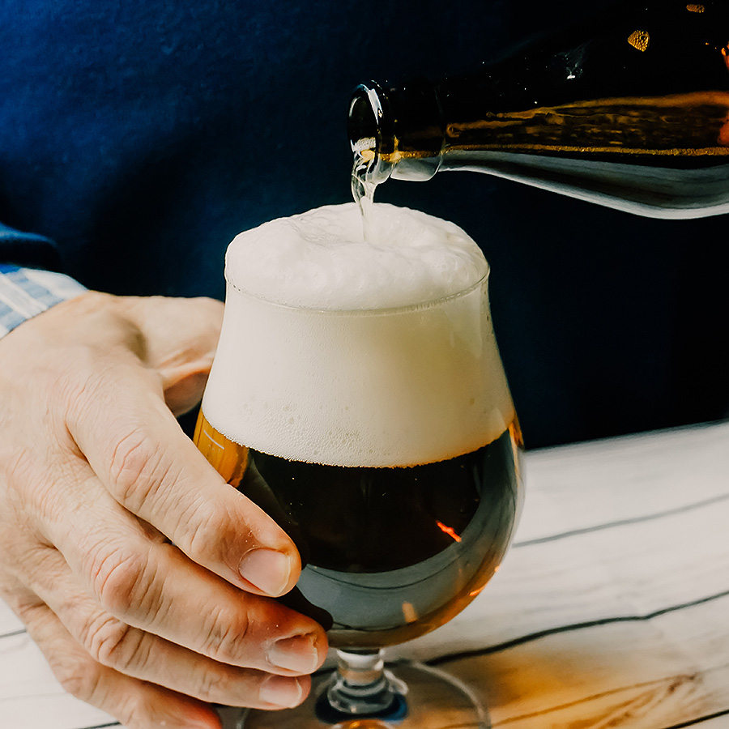
BEVERAGE
CASH BAR
Guests Pay for Their Own Drinks
(1) Bartender Per 100 Guests, $150 Bartender Fee Applies Per Bartender
PREMIUM BRANDS | $11 p/drink
DOMESTIC BEER | $8 p/drink
New Amsterdam Vodka
Bombay Original Gin
Four Roses Bourbon
Cruzan Aged Light Rum
Bushmills Whisky
Corazon Tequila Blanco
Remy Martin 1738 Accord Royal Cognac
The Famous Grouse Scotch
Bud Light, Miller Light, Coors Light
IMPORTED/CRAFT BEER | $9 p/drink
Heineken, Amstel Light, Modelo Especial, Lagunitas IPA, Pacifico, Blue Moon Belgian White, Samuel Adams Boston Lager, Angry Orchard Hard Cider, White Claw Hard Seltzer
PREMIUM WINE | $10 p/glass
30 Degree Chardonnay, Cabernet Sauvignon; La Marca Prosecco
ULTRA PREMIUM BRANDS | $13 p/drink
Absolut Vodka, Titos
Bombay Sapphire Gin
Maker’s Mark Bourbon
Ron Zacapa 23 Solara Rum
Jack Daniel’s Whiskey, Crown Royal Whiskey
Don Julio Tequila (hotel choice w/in line)
Courvoisier VSOP Cognac
Johnnie Walker Black Scotch
ULTRA PREMIUM WINE | $14 p/glass
Kim Crawford Sauvignon Blanc, Sea Sun by Wagner Chardonnay, Piper Sonoma Brut NV, Gris Blanc Rose, Meiomi Pinot Noir, Starmont Cabernet Sauvignon
NON-ALCOHOLIC BEVERAGES | $5 p/drink
Bottled and Still Sparkling Water
Assorted Soft Drinks
Signature Non-Alcoholic Cocktail(s)
All pricing is per person, a 21% taxable service charge and 9.5% sales tax will apply to all food and non-liquor beverage.
Liquor pricing includes tax. Pricing ,sales tax and service charge are subject to change

Slide 29
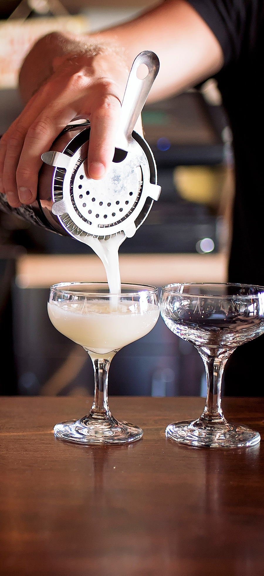
BEVERAGE
SIGNATURE COCKTAILS
Add a Signature Cocktail to Your Event as a Welcome Drink or All Event Offering
Charged on Consumption, Hosted or Cash
CROWNED JEWEL MULE | $14 p/drink
BOULVARDIER | $15 p/drink
Ketel One vodka, Fever-Tree ginger beer, cranberry juice, blood orange bitters, fresh lime juice
Four Roses bourbon, Campari, M&R sweet vermouth
MARGARITA | $13 p/drink
ITALIAN CITRONADE | $14 p/drink
Corazón Blanco tequila, Cointreau, house made simple syrup, fresh lime juice
Absolute Citron vodka, Disaronno, housemade lemon sour, Fever-Tree club soda
CROWNE ROSE MANHATTAN | $15 p/drink
ESPRESSO MARTINI | $13 p/drink
Four Roses bourbon, M&R sweet vermouth, Angostura bitters
Tito’s Housemade vodka, coffee liqueur, espresso, housemade simple syrup, optional creamer
KNOB CREEK RYE OLD FASHION | $14 p/drink
Knob Creek Rye, housemade simple syrup, orange bitters
CUSTOME SIGNATURE DRINK |
priced based on creation
CUCUMBER CHAMPAGNE COOLER | $14 p/drink
Piper-Sonoma Brut NV, muddled cucumber, housemade simple syrup, muddled mint leaves
All pricing is per person, a 21% taxable service charge and 9.5% sales tax will apply to all food and non-liquor beverage.
Liquor pricing includes tax. Pricing ,sales tax and service charge are subject to change

